Slide 1
eMasters – Communication Systems E900-Applied Linear Algebra
Notes, References, Questions, Problems, and Solutions
Venkateswar Reddy Melachervu
Jan 2023

Slide 2
Lecture 1

Slide 3
Motivation for Applied Linear Algebra
Applied linear algebra application 4G/5G wireless systems
Each antenna requires two ports on-board the device
Every decade wireless generation changes – so far
3G → 4G → 5G – 1 port/antenna → 4/8 port/antennae → 64 port/antennae

Slide 4
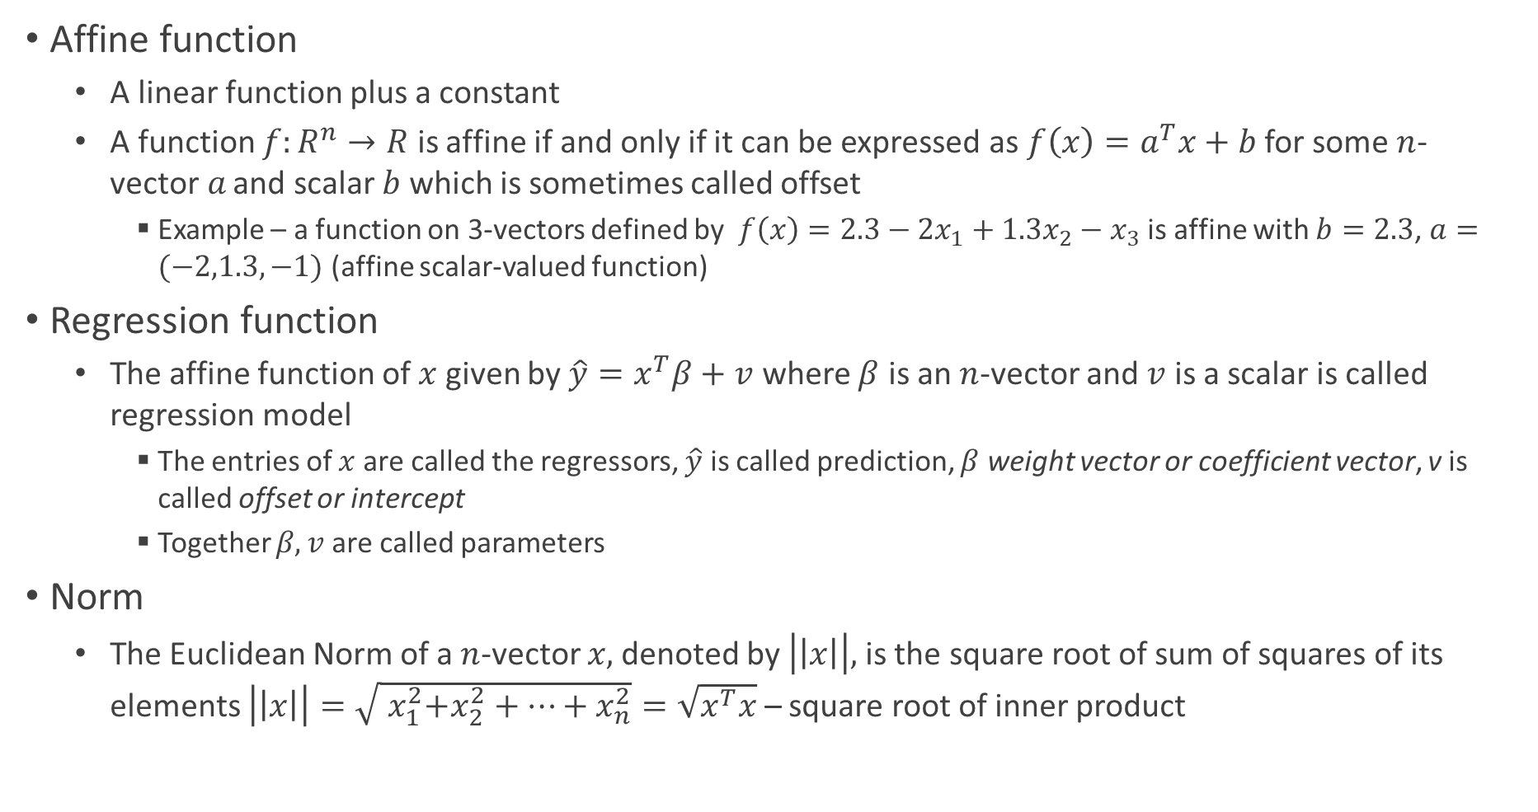
Functions
Affine function
A linear function plus a constant
A function $f:R^{n}→R$ is affine if and only if it can be expressed as $f\left(x\right)=a^{T}x+b$ for some $n$-vector$a$ and scalar $b$ which is sometimes called offset
Example – a function on 3-vectors defined by $f\left(x\right)=2.3−2x_{1}+1.3x_{2}−x_{3}$ is affine with $b=2.3$, $a=(−2,1.3,−1)$ (affine scalar-valued function)
Regression function
The affine function of $x$ given by $\hat{y}=x^{T}β+v$ where $β$ is an $n$-vector and $v$ is a scalar is called regression model
The entries of $x$ are called the regressors, $\hat{y}$ is called prediction, $β$ weight vector or coefficient vector, v is called offset or intercept
Together $β, v$ are called parameters
Norm
The Euclidean Norm of a $n$-vector $x,$denoted by $\left|\left|x\right|\right|,$is the square root of sum of squares of its elements $\left|\left|x\right|\right|=\sqrt{{ x}_{1}^{2}+x_{2}^{2}+…+x_{n}^{2}}=\sqrt{x^{T}x}$ – square root of inner product

Slide 5
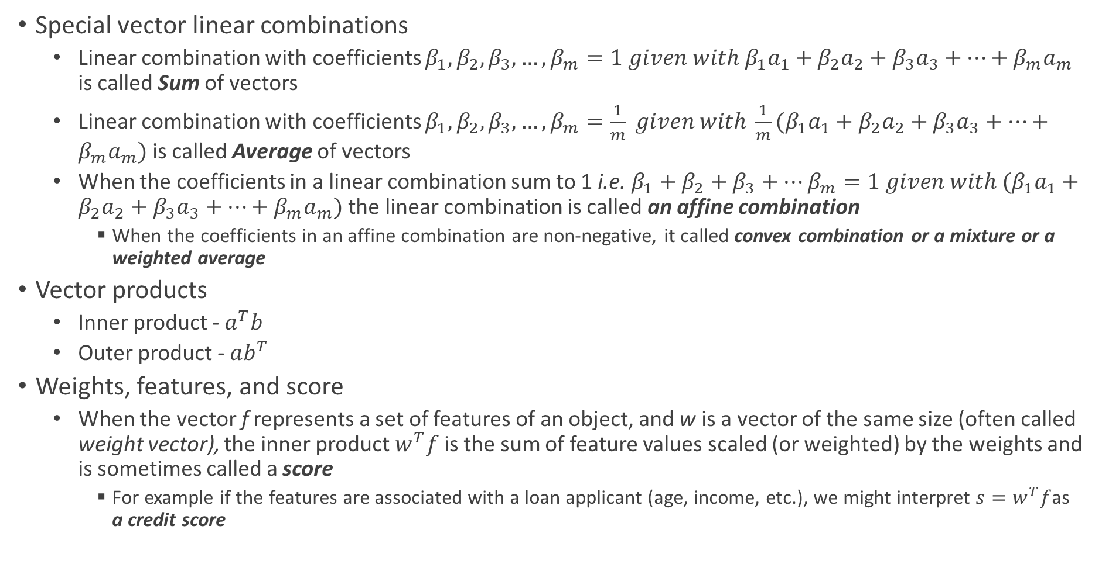
Vectors
Special vector linear combinations
Linear combination with coefficients $β_{1}, β_{2},β_{3},…,β_{m}=1 given with {β_{1}a}_{1}+{β_{2}a}_{2}+{β_{3}a}_{3}+…+{β_{m}a}_{m}$ is called Sum of vectors
Linear combination with coefficients $β_{1}, β_{2},β_{3},…,β_{m}=\frac{1}{m} given with \frac{1}{m}({β_{1}a}_{1}+{β_{2}a}_{2}+{β_{3}a}_{3}+…+{β_{m}a}_{m})$ is called Average of vectors
When the coefficients in a linear combination sum to 1 i.e. $β_{1}+β_{2}+β_{3}+…β_{m}=1 given with ({β_{1}a}_{1}+{β_{2}a}_{2}+{β_{3}a}_{3}+…+{β_{m}a}_{m})$ the linear combination is called an affine combination
When the coefficients in an affine combination are non-negative, it called convex combination or a mixture or a weighted average
Vector products
Inner product - $a^{T}b$
Outer product - $ab^{T}$
Weights, features, and score
When the vector f represents a set of features of an object, and w is a vector of the same size (often called weight vector), the inner product $w^{T}f$ is the sum of feature values scaled (or weighted) by the weights and is sometimes called a score
For example if the features are associated with a loan applicant (age, income, etc.), we might interpret $s=w^{T}f$as a credit score

Slide 6
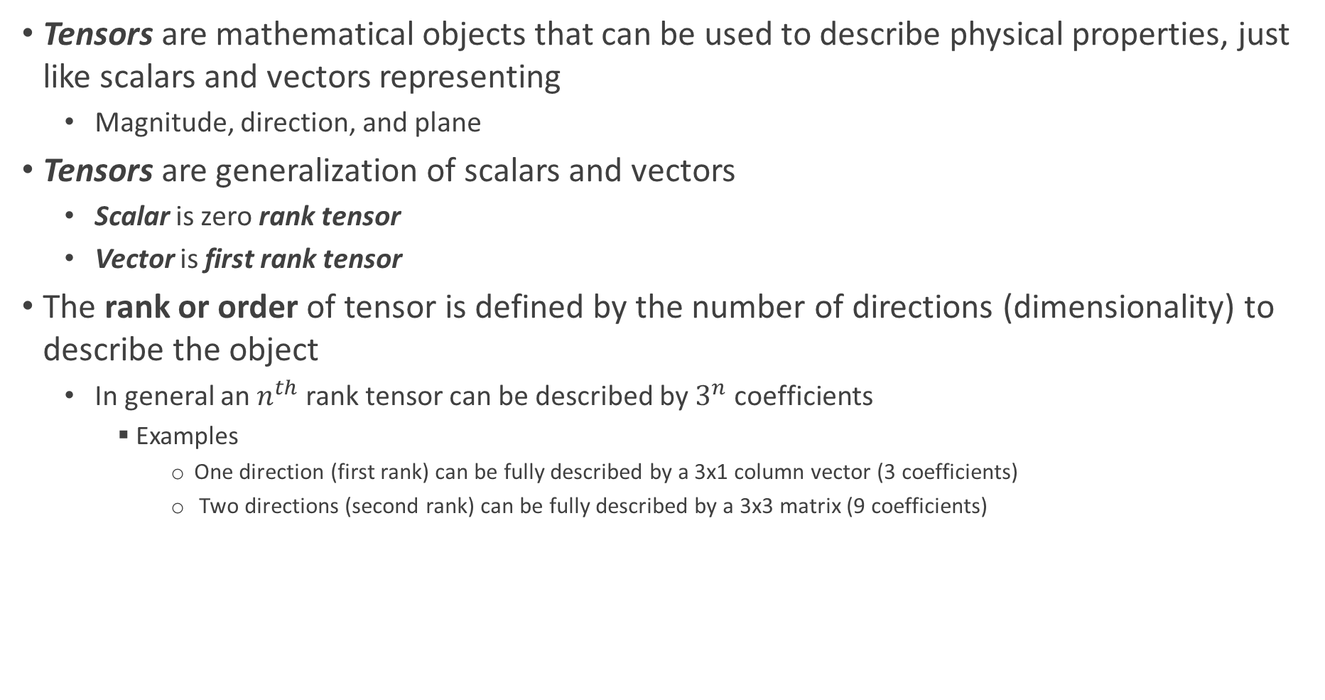
Vectors
Tensors are mathematical objects that can be used to describe physical properties, just like scalars and vectors representing
Magnitude, direction, and plane
Tensors are generalization of scalars and vectors
Scalar is zero rank tensor
Vector is first rank tensor
The rank or order of tensor is defined by the number of directions (dimensionality) to describe the object
In general an $n^{th}$ rank tensor can be described by $3^{n}$ coefficients
Examples
One direction (first rank) can be fully described by a 3x1 column vector (3 coefficients)
Two directions (second rank) can be fully described by a 3x3 matrix (9 coefficients)

Slide 7
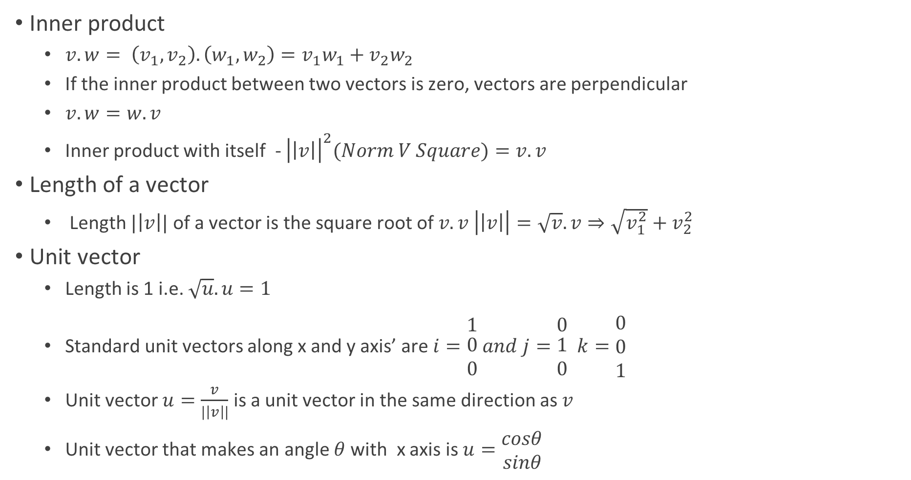
Vectors
Inner product
$v.w= \left(v_{1},v_{2}\right).\left(w_{1},w_{2}\right)=v_{1}w_{1}+v_{2}w_{2}$
If the inner product between two vectors is zero, vectors are perpendicular
$v.w=w.v$
Inner product with itself - ${\left|\left|v\right|\right|}^{2}(Norm V Square)=v.v$
Length of a vector
Length $|\left|v\right||$ of a vector is the square root of $v.v \left|\left|v\right|\right|=\sqrt{v}.v⇒\sqrt{v_{1}^{2}}+v_{2}^{2}$
Unit vector
Length is 1 i.e. $\sqrt{u}.u=1$
Standard unit vectors along x and y axis’ are $i=\begin{matrix}1 \\ \begin{aligned}0 \\ 0\end{aligned}\end{matrix} and j=\begin{matrix}0 \\ \begin{aligned}1 \\ 0\end{aligned}\end{matrix} k=\begin{matrix}0 \\ 0 \\ 1\end{matrix}$
Unit vector $u=\frac{v}{|\left|v\right||}$ is a unit vector in the same direction as $v$
Unit vector that makes an angle $θ$with x axis is $u=\begin{matrix}cosθ \\ sinθ\end{matrix}$

Slide 8
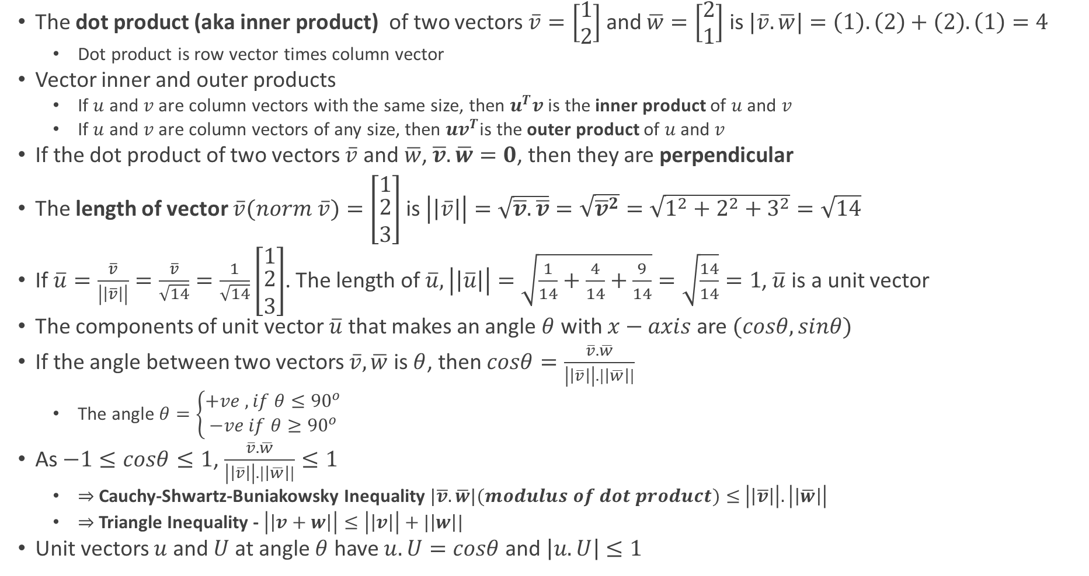
Lengths and Dot Products
The dot product (aka inner product) of two vectors $\overline{v}=\left[\begin{matrix}1 \\ 2\end{matrix}\right]$ and $\overline{w}=\left[\begin{matrix}2 \\ 1\end{matrix}\right]$ is $|\overline{v}.\overline{w}|=\left(1\right).\left(2\right)+\left(2\right).\left(1\right)=4$
Dot product is row vector times column vector
Vector inner and outer products
If $u$ and $v$ are column vectors with the same size, then $u^{T}v$ is the inner product of $u$ and $v$
If $u$ and $v$ are column vectors of any size, then $uv^{T}$is the outer product of $u$ and $v$
If the dot product of two vectors $\overline{v}$ and $\overline{w}$, $\overline{v}.\overline{w}=0$, then they are perpendicular
The length of vector $\overline{v}(norm \overline{v})=\left[\begin{matrix}1 \\ \begin{aligned}2 \\ 3\end{aligned}\end{matrix}\right]$ is $\left|\left|\overline{v}\right|\right|=\sqrt{\overline{v}.\overline{v}}=\sqrt{{\overline{v}}^{2}}=\sqrt{1^{2}+2^{2}+3^{2}}=\sqrt{14}$
If $\overline{u}=\frac{\overline{v}}{\left|\left|\overline{v}\right|\right|}=\frac{\overline{v}}{\sqrt{14}}=\frac{1}{\sqrt{14}}\left[\begin{matrix}1 \\ \begin{aligned}2 \\ 3\end{aligned}\end{matrix}\right]$. The length of $\overline{u}, \left|\left|\overline{u}\right|\right|=\sqrt{\frac{1}{14}+\frac{4}{14}+\frac{9}{14}}=\sqrt{\frac{14}{14}}=1$, $\overline{u}$ is a unit vector
The components of unit vector $\overline{u}$ that makes an angle $θ$ with $x−axis$ are $(cosθ, sinθ)$
If the angle between two vectors $\overline{v}, \overline{w}$ is $θ$, then $cosθ=\frac{\overline{v}.\overline{w}}{\left|\left|\overline{v}\right|\right|.|\left|\overline{w}\right||}$
The angle $θ=\left\{\begin{aligned}+ve , if θ≤{90}^{o} \\ −ve if θ≥{90}^{o}\end{aligned}\right.$
As $−1≤cosθ≤1$, $\frac{\overline{v}.\overline{w}}{\left|\left|\overline{v}\right|\right|.|\left|\overline{w}\right||}≤1$
$⇒$Cauchy-Shwartz-Buniakowsky Inequality $|\overline{v}.\overline{w}|(modulus of dot product)≤$ $\left|\left|\overline{v}\right|\right|.\left|\left|\overline{w}\right|\right|$
$⇒$Triangle Inequality - $\left|\left|v+w\right|\right|≤\left|\left|v\right|\right|+|\left|w\right||$
Unit vectors $u$ and $U$ at angle $θ$ have $u.U=cosθ$ and $\left|u.U\right|≤1$

Slide 9
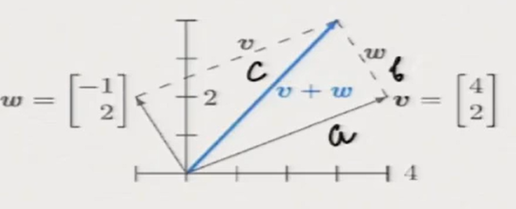
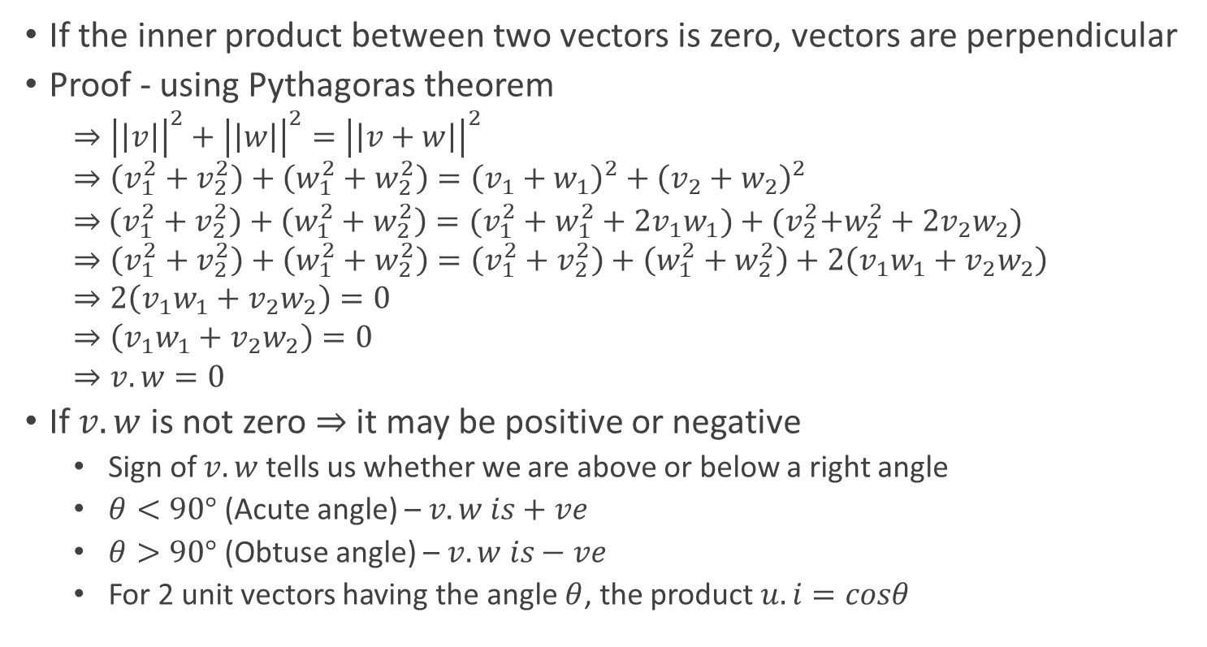
Inner Product of Perpendicular Vectors
If the inner product between two vectors is zero, vectors are perpendicular
Proof - using Pythagoras theorem
$$⇒{\left|\left|v\right|\right|}^{2}+{\left|\left|w\right|\right|}^{2}={\left|\left|v+w\right|\right|}^{2}$$
$$⇒\left(v_{1}^{2}+v_{2}^{2}\right)+\left(w_{1}^{2}+w_{2}^{2}\right)={\left(v_{1}+w_{1}\right)}^{2}+{\left(v_{2}+w_{2}\right)}^{2}$$
$⇒$ $\left(v_{1}^{2}+v_{2}^{2}\right)+\left(w_{1}^{2}+w_{2}^{2}\right)=(v_{1}^{2}+w_{1}^{2}+2v_{1}w_{1})+{(v}_{2}^{2}+w_{2}^{2}+2v_{2}w_{2})$
$$⇒\left(v_{1}^{2}+v_{2}^{2}\right)+\left(w_{1}^{2}+w_{2}^{2}\right)=\left(v_{1}^{2}+v_{2}^{2}\right)+\left(w_{1}^{2}+w_{2}^{2}\right)+2\left(v_{1}w_{1}+v_{2}w_{2}\right)$$
$$⇒2\left(v_{1}w_{1}+v_{2}w_{2}\right)=0$$
$$⇒\left(v_{1}w_{1}+v_{2}w_{2}\right)=0$$
$$⇒v.w=0$$
If $v.w$ is not zero $⇒$ it may be positive or negative
Sign of $v.w$ tells us whether we are above or below a right angle
$θ<90°$ (Acute angle) – $v.w is+ve$
$θ>90°$ (Obtuse angle) – $v.w is−ve$
For 2 unit vectors having the angle $θ$, the product $u.i=cosθ$

Slide 10
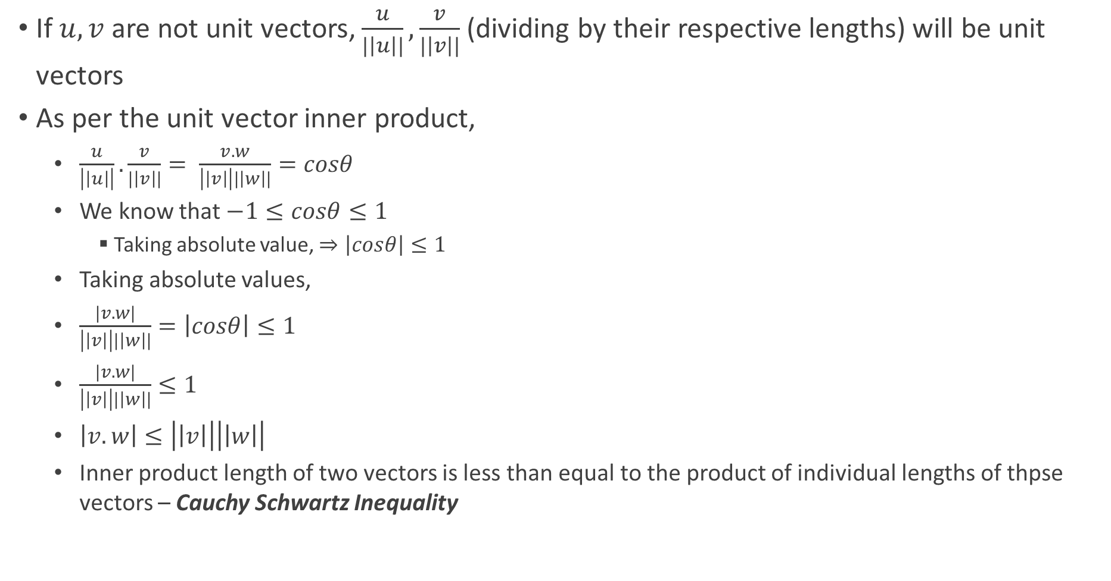
Inner Product of Non-unit Vectors
If $u,v$ are not unit vectors, $\frac{u}{|\left|u\right||},\frac{v}{|\left|v\right||}$ (dividing by their respective lengths) will be unit vectors
As per the unit vector inner product,
$\frac{u}{\left|\left|u\right|\right|}.\frac{v}{|\left|v\right||}= \frac{v.w}{\left|\left|v\right|\right||\left|w\right||}=cosθ$
We know that $−1≤cosθ≤1$
Taking absolute value, $⇒\left|cosθ\right|≤1$
Taking absolute values,
$\frac{|v.w|}{\left|\left|v\right|\right||\left|w\right||}=\left|cosθ\right|≤1$
$\frac{|v.w|}{\left|\left|v\right|\right||\left|w\right||}≤1$
$\left|v.w\right|≤\left|\left|v\right|\right|\left|\left|w\right|\right|$
Inner product length of two vectors is less than equal to the product of individual lengths of thpse vectors – Cauchy Schwartz Inequality

Slide 11
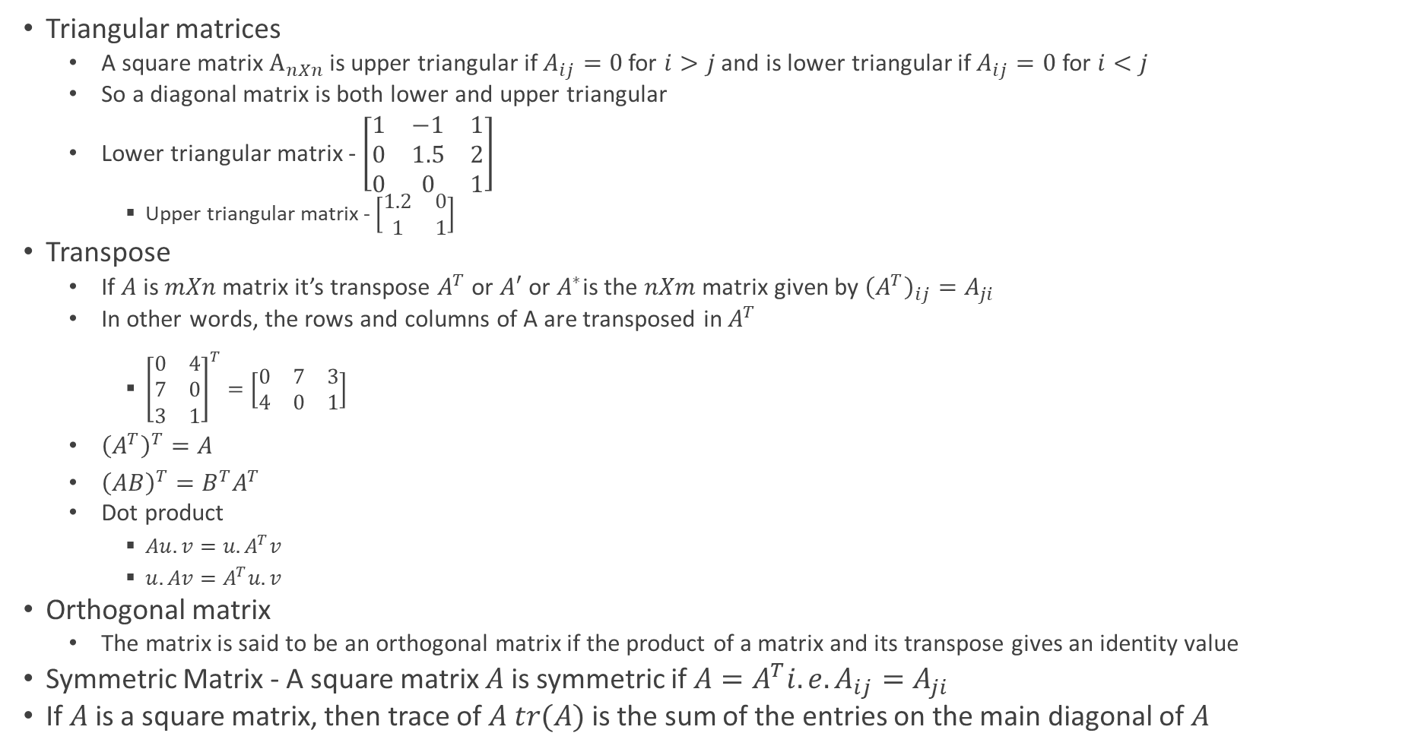
Matrices
Triangular matrices
A square matrix $A_{nXn}$is upper triangular if $A_{ij}=0$ for $i>j$ and is lower triangular if $A_{ij}=0$ for $i<j$
So a diagonal matrix is both lower and upper triangular
Lower triangular matrix - $\left[\begin{matrix}1 & −1 & 1 \\ 0 & 1.5 & 2 \\ 0 & 0 & 1\end{matrix}\right]$
Upper triangular matrix - $\left[\begin{matrix}1.2 & 0 \\ 1 & 1\end{matrix}\right]$
Transpose
If $A$ is $mXn$ matrix it’s transpose $A^{T}$ or $A′$ or $A^{∗}$is the $nXm$ matrix given by ${\left(A^{T}\right)}_{ij}=A_{ji}$
In other words, the rows and columns of A are transposed in $A^{T}$
${\left[\begin{matrix}0 & 4 \\ 7 & 0 \\ 3 & 1\end{matrix}\right]}^{T}=\left[\begin{matrix}0 & 7 & 3 \\ 4 & 0 & 1\end{matrix}\right]$
${\left(A^{T}\right)}^{T}=A$
${\left(AB\right)}^{T}=B^{T}A^{T}$
Dot product
$Au.v=u.A^{T}v$
$u.Av=A^{T}u.v$
Orthogonal matrix
The matrix is said to be an orthogonal matrix if the product of a matrix and its transpose gives an identity value
Symmetric Matrix - A square matrix $A$ is symmetric if $A=A^{T}i.e.A_{ij}=A_{ji}$
If $A$ is a square matrix, then trace of $A$ $tr(A)$ is the sum of the entries on the main diagonal of $A$

Slide 12
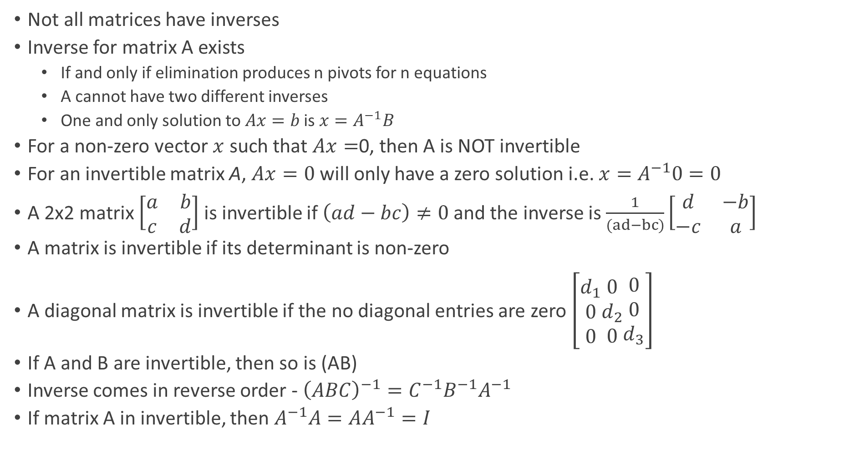
Matrix Transpose, Inverse, and Their Properties
Not all matrices have inverses
Inverse for matrix A exists
If and only if elimination produces n pivots for n equations
A cannot have two different inverses
One and only solution to $Ax=b$ is $x=A^{−1}B$
For a non-zero vector $x$ such that $Ax=$0, then A is NOT invertible
For an invertible matrix A, $Ax=0$ will only have a zero solution i.e. $x=A^{−1}0=0$
A 2x2 matrix $\left[\begin{matrix}a & b \\ c & d\end{matrix}\right]$ is invertible if $\left(ad−bc\right)≠0$ and the inverse is $\frac{1}{(ad−bc)}\left[\begin{matrix}d & −b \\ −c & a\end{matrix}\right]$
A matrix is invertible if its determinant is non-zero
A diagonal matrix is invertible if the no diagonal entries are zero $\left[\begin{matrix}d_{1} \\ 0 \\ 0\end{matrix}\begin{matrix}0 \\ d_{2} \\ 0\end{matrix}\begin{matrix}0 \\ 0 \\ d_{3}\end{matrix}\right]$
If A and B are invertible, then so is (AB)
Inverse comes in reverse order - ${\left(ABC\right)}^{−1}=C^{−1}B^{−1}A^{−1}$
If matrix A in invertible, then $A^{−1}A=AA^{−1}=I$

Slide 13
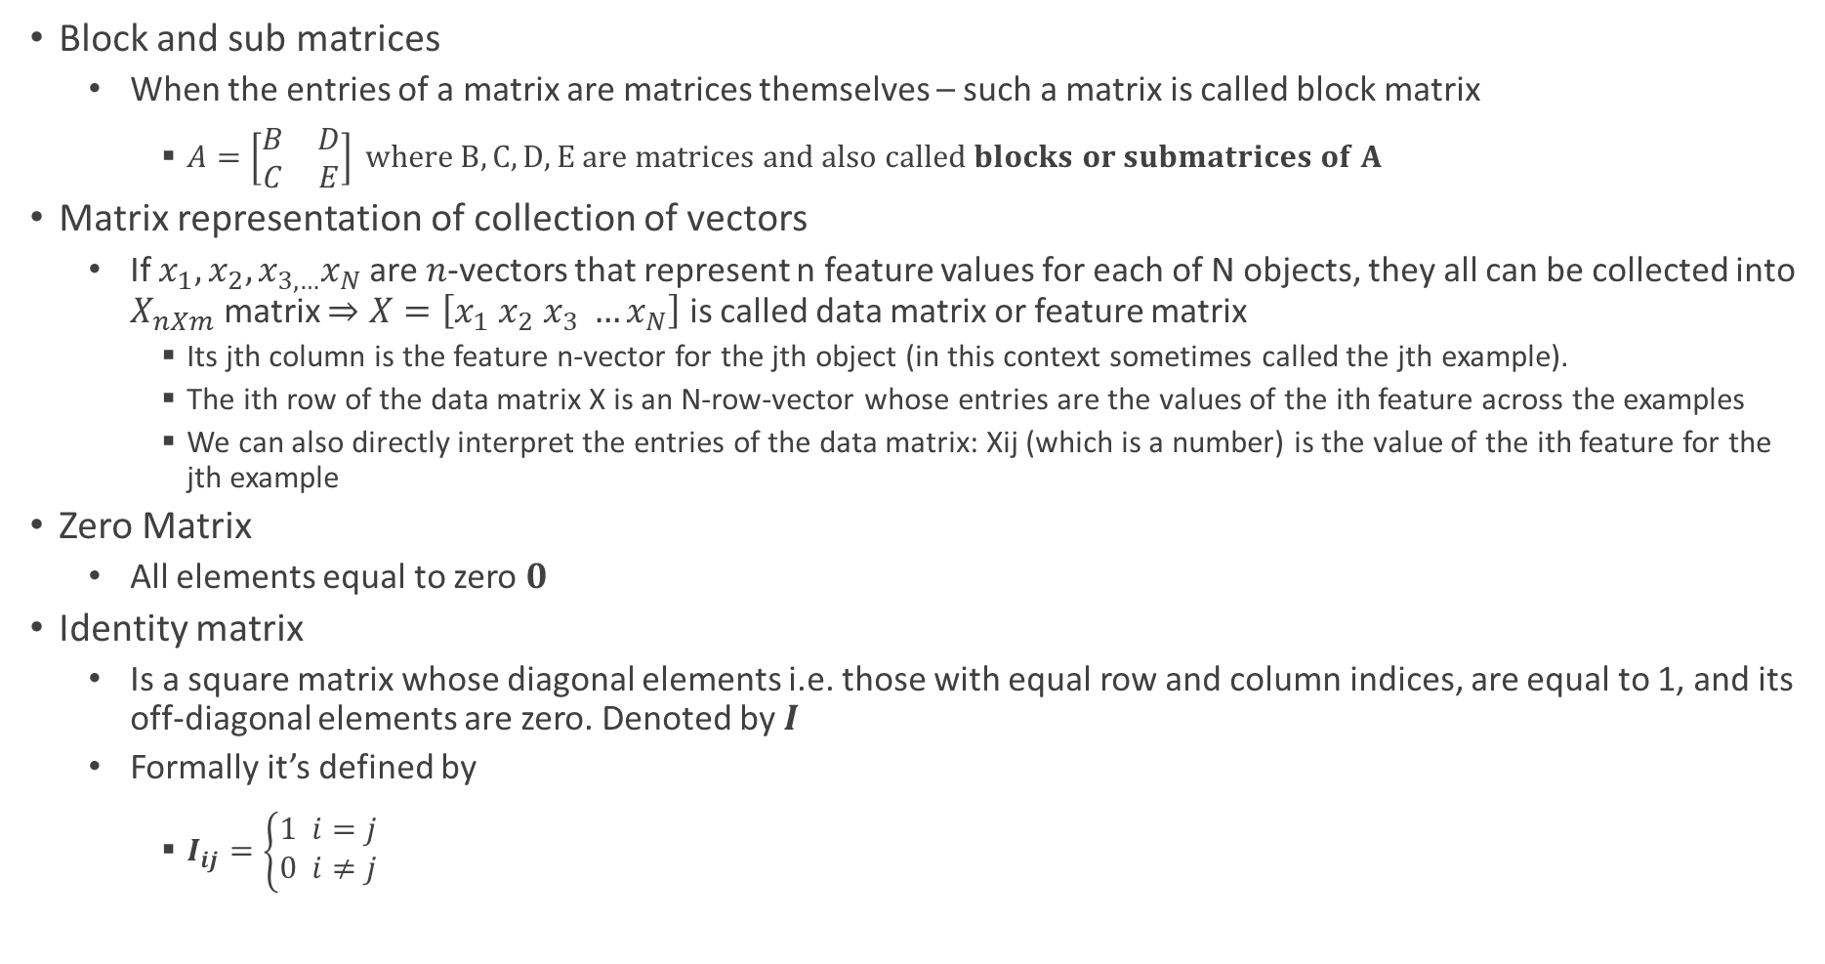
Matrices
Block and sub matrices
When the entries of a matrix are matrices themselves – such a matrix is called block matrix
$A=\left[\begin{matrix}B & D \\ C & E\end{matrix}\right] where B,C,D,E are matrices and also called blocks or submatrices of A$
Matrix representation of collection of vectors
If $x_{1},x_{2},x_{3,…}x_{N}$ are $n$-vectors that represent n feature values for each of N objects, they all can be collected into $X_{nXm}$ matrix $⇒X=\left[x_{1} x_{2} x_{3} …x_{N}\right]$ is called data matrix or feature matrix
Its jth column is the feature n-vector for the jth object (in this context sometimes called the jth example).
The ith row of the data matrix X is an N-row-vector whose entries are the values of the ith feature across the examples
We can also directly interpret the entries of the data matrix: Xij (which is a number) is the value of the ith feature for the jth example
Zero Matrix
All elements equal to zero $0$
Identity matrix
Is a square matrix whose diagonal elements i.e. those with equal row and column indices, are equal to 1, and its off-diagonal elements are zero. Denoted by $I$
Formally it’s defined by
$I_{ij}=\left\{\begin{aligned}&1 i=j \\ &0 i≠j\end{aligned}\right.$

Slide 14
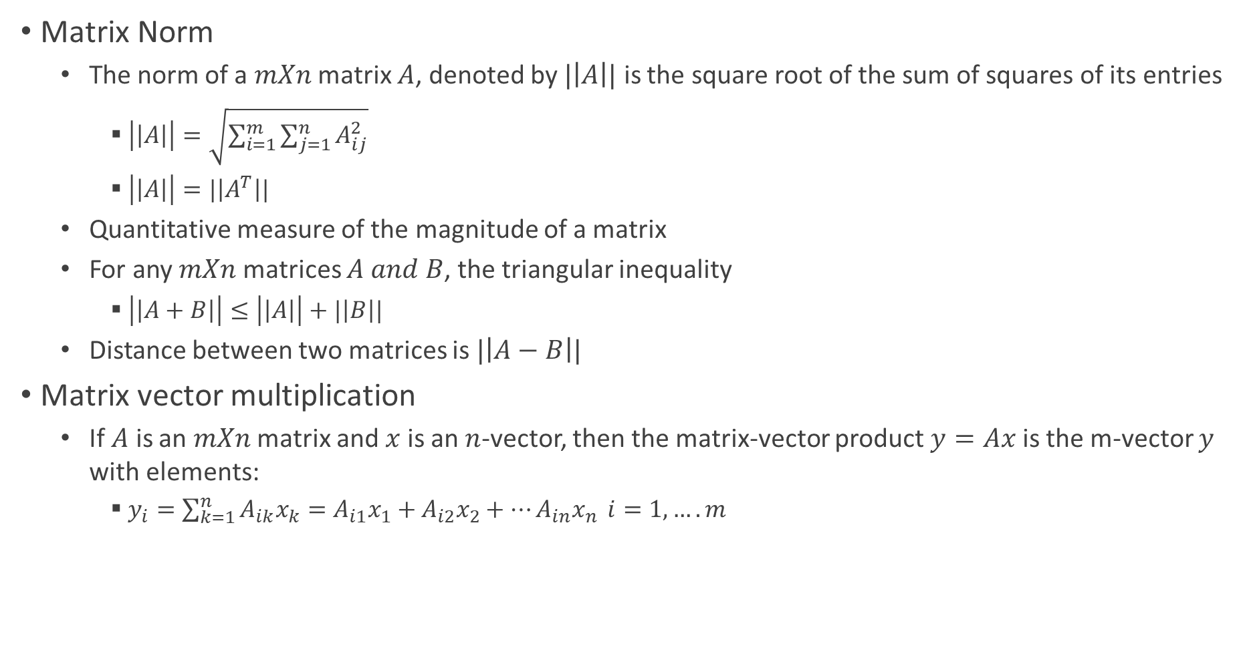
Matrices
Matrix Norm
The norm of a $mXn$ matrix $A$, denoted by $|\left|A\right||$ is the square root of the sum of squares of its entries
$\left|\left|A\right|\right|=\sqrt{\sum_{i=1}^{m}{\sum_{j=1}^{n}{A_{ij}^{2}}}}$
$\left|\left|A\right|\right|=|\left|A^{T}\right||$
Quantitative measure of the magnitude of a matrix
For any $mXn$ matrices $A and B$, the triangular inequality
$\left|\left|A+B\right|\right|≤\left|\left|A\right|\right|+|\left|B\right||$
Distance between two matrices is $|\left|A−B\right||$
Matrix vector multiplication
If $A$ is an $mXn$ matrix and $x$ is an $n$-vector, then the matrix-vector product $y=Ax$ is the m-vector $y$ with elements:
$y_{i}=\sum_{k=1}^{n}{A_{ik}x_{k}=A_{i1}x_{1}+A_{i2}x_{2}+…A_{in}x_{n}} i=1,….m$

Slide 15
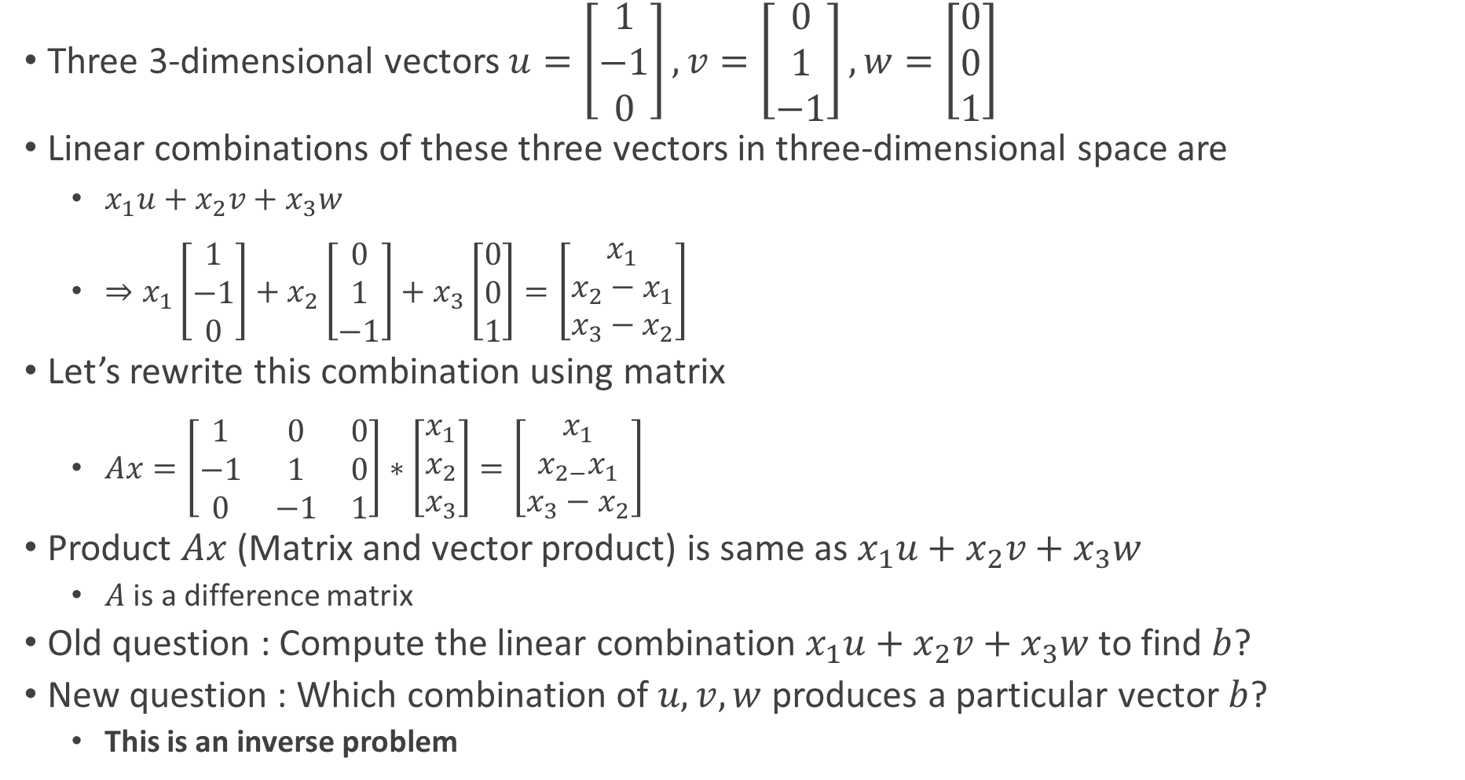
Matrices
Three 3-dimensional vectors $u=\left[\begin{matrix}1 \\ −1 \\ 0\end{matrix}\right],v=\left[\begin{matrix}0 \\ 1 \\ −1\end{matrix}\right],w=\left[\begin{matrix}0 \\ 0 \\ 1\end{matrix}\right]$
Linear combinations of these three vectors in three-dimensional space are
$x_{1}u+x_{2}v+x_{3}w$
$⇒x_{1}\left[\begin{matrix}1 \\ −1 \\ 0\end{matrix}\right]+x_{2}\left[\begin{matrix}0 \\ 1 \\ −1\end{matrix}\right]+x_{3}\left[\begin{matrix}0 \\ 0 \\ 1\end{matrix}\right]=\left[\begin{matrix}x_{1} \\ x_{2}−x_{1} \\ x_{3}−x_{2}\end{matrix}\right]$
Let’s rewrite this combination using matrix
$Ax=\left[\begin{matrix}1 & 0 & 0 \\ −1 & 1 & 0 \\ 0 & −1 & 1\end{matrix}\right]∗\left[\begin{matrix}x_{1} \\ x_{2} \\ x_{3}\end{matrix}\right]=\left[\begin{matrix}x_{1} \\ x_{2−}x_{1} \\ x_{3}−x_{2}\end{matrix}\right]$
Product $Ax$ (Matrix and vector product) is same as $x_{1}u+x_{2}v+x_{3}w$
$A$ is a difference matrix
Old question : Compute the linear combination $x_{1}u+x_{2}v+x_{3}w$ to find $b$?
New question : Which combination of $u,v,w$ produces a particular vector $b$?
This is an inverse problem

Slide 16
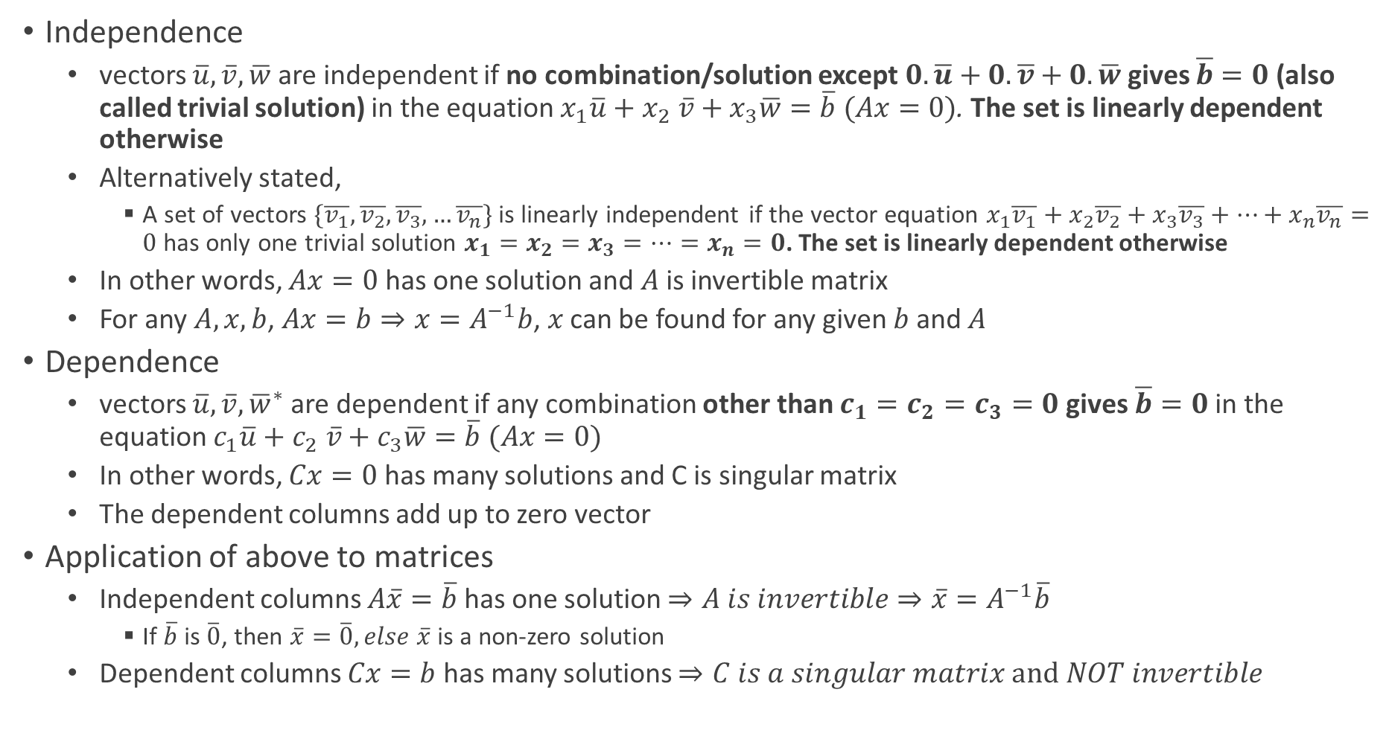
Independence and Dependence
Independence
vectors $\overline{u},\overline{v},\overline{w}$ are independent if no combination/solution except $0.\overline{u}+0.\overline{v}+0.\overline{w}$ gives $\overline{b}=0$ (also called trivial solution) in the equation $x_{1}\overline{u}+x_{2} \overline{v}+x_{3}\overline{w}=\overline{b} (Ax=0)$. The set is linearly dependent otherwise
Alternatively stated,
A set of vectors $\{\overline{v_{1}},\overline{v_{2}},\overline{v_{3}},…\overline{v_{n}}\}$ is linearly independent if the vector equation $x_{1}\overline{v_{1}}+x_{2}\overline{v_{2}}+x_{3}\overline{v_{3}}+…+x_{n}\overline{v_{n}}=0$ has only one trivial solution $x_{1}=x_{2}=x_{3}=…=x_{n}=0$. The set is linearly dependent otherwise
In other words, $Ax=0$ has one solution and $A$ is invertible matrix
For any $A,x,b$, $Ax=b⇒x=A^{−1}b$, $x$ can be found for any given $b$ and $A$
Dependence
vectors $\overline{u},\overline{v},{\overline{w}}^{∗}$ are dependent if any combination other than $c_{1}=c_{2}=c_{3}=0$gives $\overline{b}=0$ in the equation $c_{1}\overline{u}+c_{2} \overline{v}+c_{3}\overline{w}=\overline{b} (Ax=0)$
In other words, $Cx=0$ has many solutions and C is singular matrix
The dependent columns add up to zero vector
Application of above to matrices
Independent columns $A\overline{x}=\overline{b}$has one solution $⇒A is invertible⇒\overline{x}=A^{−1}\overline{b}$
If $\overline{b}$ is $\overline{0}$, then $\overline{x}=\overline{0}, else \overline{x}$ is a non-zero solution
Dependent columns $Cx=b$ has many solutions $⇒C is a singular matrix and NOT invertible$

Slide 17
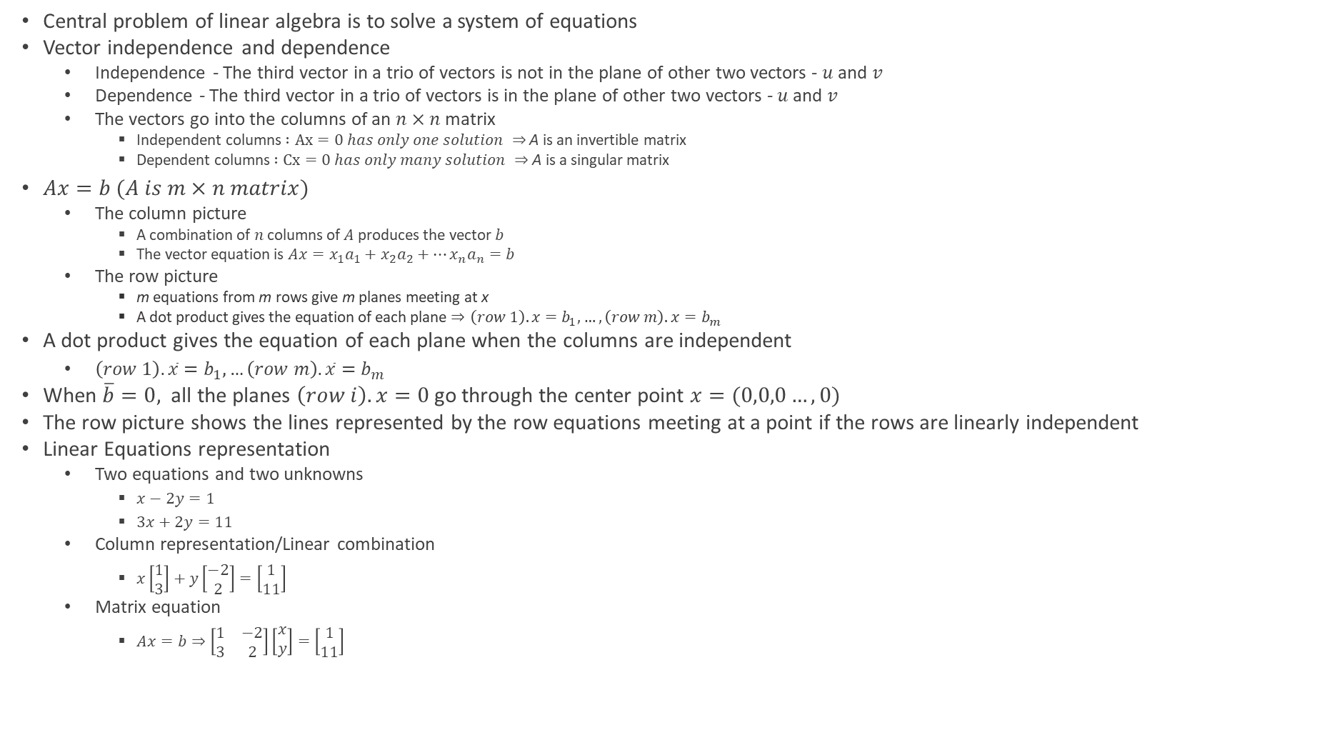
Solving Linear Equations
Central problem of linear algebra is to solve a system of equations
Vector independence and dependence
Independence - The third vector in a trio of vectors is not in the plane of other two vectors - $u$ and $v$
Dependence - The third vector in a trio of vectors is in the plane of other two vectors - $u$ and $v$
The vectors go into the columns of an $n×n$ matrix
Independent columns $:Ax=0 has only one solution ⇒$ A is an invertible matrix
Dependent columns $:Cx=0 has only many solution ⇒$ A is a singular matrix
$Ax=b (A is m×n matrix)$
The column picture
A combination of $n$ columns of $A$ produces the vector $b$
The vector equation is $Ax=x_{1}a_{1}+x_{2}a_{2}+…x_{n}a_{n}=b$
The row picture
m equations from m rows give m planes meeting at x
A dot product gives the equation of each plane $⇒\left(row 1\right).x=b_{1},…,\left(row m\right).x=b_{m}$
A dot product gives the equation of each plane when the columns are independent
$\left(row 1\right).\overline{x}=b_{1},…\left(row m\right).\overline{x}=b_{m}$
When $\overline{b}=0,$ all the planes $\left(row i\right).x=0$go through the center point $x=(0,0,0…,0)$
The row picture shows the lines represented by the row equations meeting at a point if the rows are linearly independent
Linear Equations representation
Two equations and two unknowns
$x−2y=1$
$3x+2y=11$
Column representation/Linear combination
$x\left[\begin{aligned}1 \\ 3\end{aligned}\right]+y\left[\begin{aligned}−2 \\ 2\end{aligned}\right]=\left[\begin{aligned}1 \\ 11\end{aligned}\right]$
Matrix equation
$Ax=b⇒\left[\begin{matrix}1 & −2 \\ 3 & 2\end{matrix}\right]\left[\begin{aligned}x \\ y\end{aligned}\right]=\left[\begin{aligned}1 \\ 11\end{aligned}\right]$

Slide 18
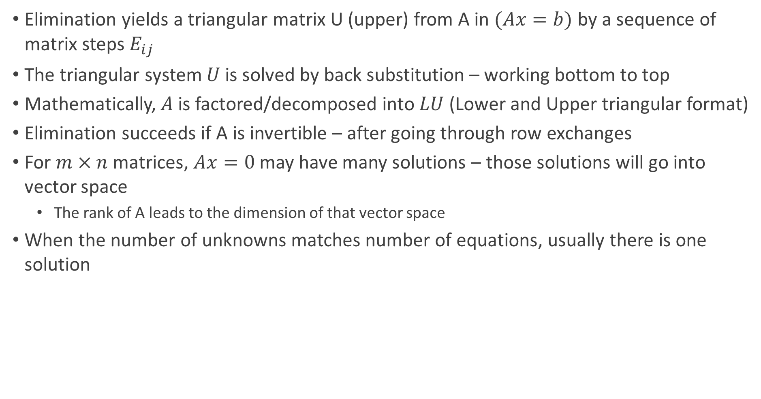
Solving Linear Equations
Elimination yields a triangular matrix U (upper) from A in $(Ax=b)$ by a sequence of matrix steps $E_{ij}$
The triangular system $U$ is solved by back substitution – working bottom to top
Mathematically, $A$ is factored/decomposed into $LU$ (Lower and Upper triangular format)
Elimination succeeds if A is invertible – after going through row exchanges
For $m×n$ matrices, $Ax=0$ may have many solutions – those solutions will go into vector space
The rank of A leads to the dimension of that vector space
When the number of unknowns matches number of equations, usually there is one solution

Slide 19
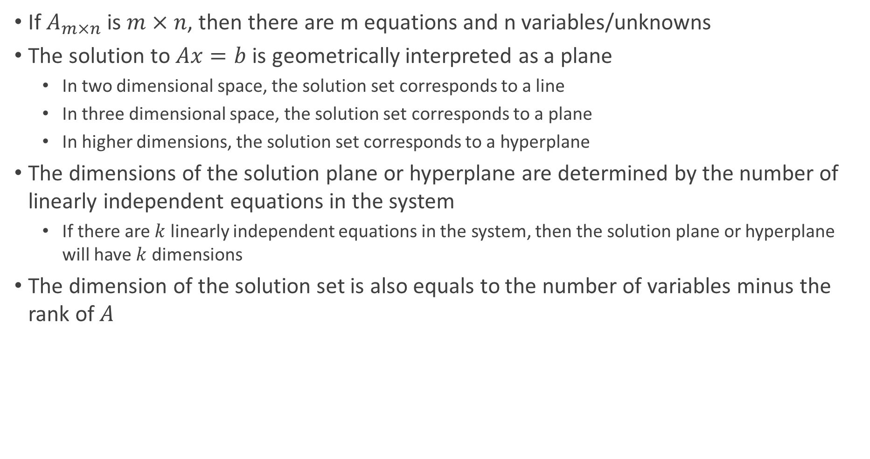
$Ax=b$ Solution Interpretation
If $A_{m×n}$ is $m×n$, then there are m equations and n variables/unknowns
The solution to $Ax=b$ is geometrically interpreted as a plane
In two dimensional space, the solution set corresponds to a line
In three dimensional space, the solution set corresponds to a plane
In higher dimensions, the solution set corresponds to a hyperplane
The dimensions of the solution plane or hyperplane are determined by the number of linearly independent equations in the system
If there are $k$ linearly independent equations in the system, then the solution plane or hyperplane will have $k$ dimensions
The dimension of the solution set is also equals to the number of variables minus the rank of $A$

Slide 20
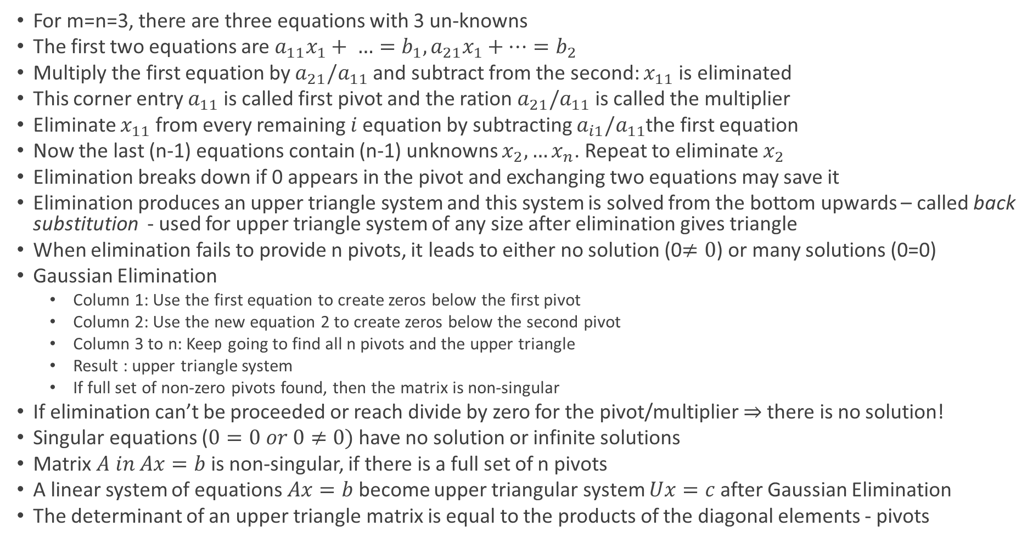
The Idea of Elimination
For m=n=3, there are three equations with 3 un-knowns
The first two equations are $a_{11}x_{1}+ …=b_{1}, a_{21}x_{1}+…=b_{2}$
Multiply the first equation by $a_{21}/a_{11}$ and subtract from the second: $x_{11}$ is eliminated
This corner entry $a_{11}$ is called first pivot and the ration $a_{21}/a_{11}$ is called the multiplier
Eliminate $x_{11}$ from every remaining $i$equation by subtracting $a_{i1}/a_{11}$the first equation
Now the last (n-1) equations contain (n-1) unknowns $x_{2},…x_{n}$. Repeat to eliminate $x_{2}$
Elimination breaks down if 0 appears in the pivot and exchanging two equations may save it
Elimination produces an upper triangle system and this system is solved from the bottom upwards – called back substitution - used for upper triangle system of any size after elimination gives triangle
When elimination fails to provide n pivots, it leads to either no solution (0$≠0$) or many solutions (0=0)
Gaussian Elimination
Column 1: Use the first equation to create zeros below the first pivot
Column 2: Use the new equation 2 to create zeros below the second pivot
Column 3 to n: Keep going to find all n pivots and the upper triangle
Result : upper triangle system
If full set of non-zero pivots found, then the matrix is non-singular
If elimination can’t be proceeded or reach divide by zero for the pivot/multiplier $⇒$ there is no solution!
Singular equations ($0=0 or 0≠0)$ have no solution or infinite solutions
Matrix $A in Ax=b$ is non-singular, if there is a full set of n pivots
A linear system of equations $Ax=b$become upper triangular system $Ux=c$ after Gaussian Elimination
The determinant of an upper triangle matrix is equal to the products of the diagonal elements - pivots

Slide 21
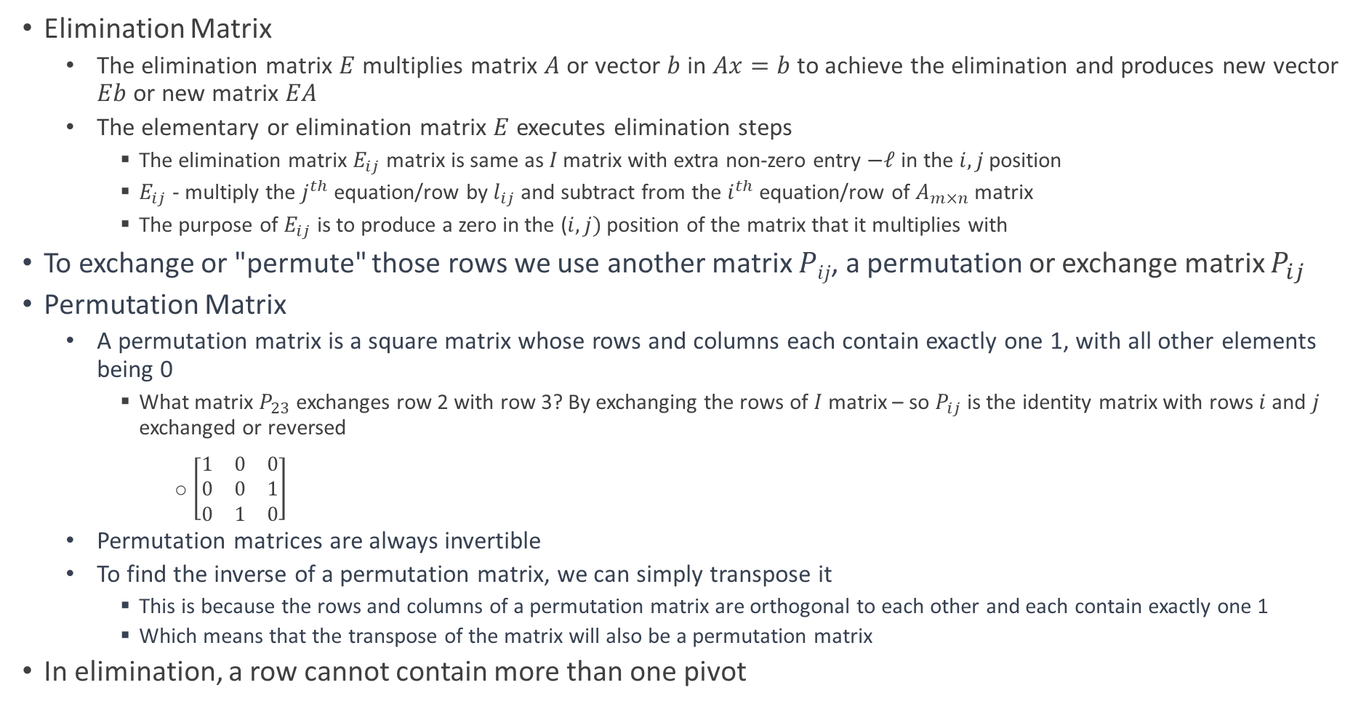
Elimination Using Matrices, Elimination and Permutation Matrices
Elimination Matrix
The elimination matrix $E$ multiplies matrix $A$or vector $b$ in $Ax=b$ to achieve the elimination and produces new vector $Eb$ or new matrix $EA$
The elementary or elimination matrix $E$ executes elimination steps
The elimination matrix $E_{ij}$ matrix is same as $I$matrix with extra non-zero entry $−ℓ$ in the $i,j$ position
$E_{ij}$ - multiply the $j^{th}$ equation/row by $l_{ij}$ and subtract from the $i^{th}$ equation/row of $A_{m×n}$ matrix
The purpose of $E_{ij}$ is to produce a zero in the ($i,j)$ position of the matrix that it multiplies with
To exchange or "permute" those rows we use another matrix $Pij$, a permutation or exchange matrix $P_{ij}$
Permutation Matrix
A permutation matrix is a square matrix whose rows and columns each contain exactly one 1, with all other elements being 0
What matrix $P_{23}$ exchanges row 2 with row 3? By exchanging the rows of $I$ matrix – so $P_{ij}$ is the identity matrix with rows $i$ and $j$ exchanged or reversed
$\left[\begin{matrix}1 & 0 & 0 \\ 0 & 0 & 1 \\ 0 & 1 & 0\end{matrix}\right]$
Permutation matrices are always invertible
To find the inverse of a permutation matrix, we can simply transpose it
This is because the rows and columns of a permutation matrix are orthogonal to each other and each contain exactly one 1
Which means that the transpose of the matrix will also be a permutation matrix
In elimination, a row cannot contain more than one pivot

Slide 22
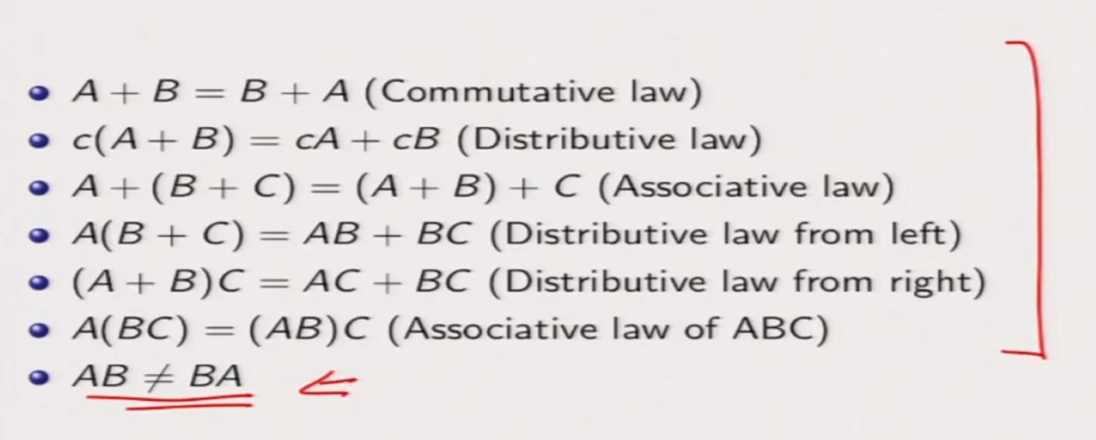
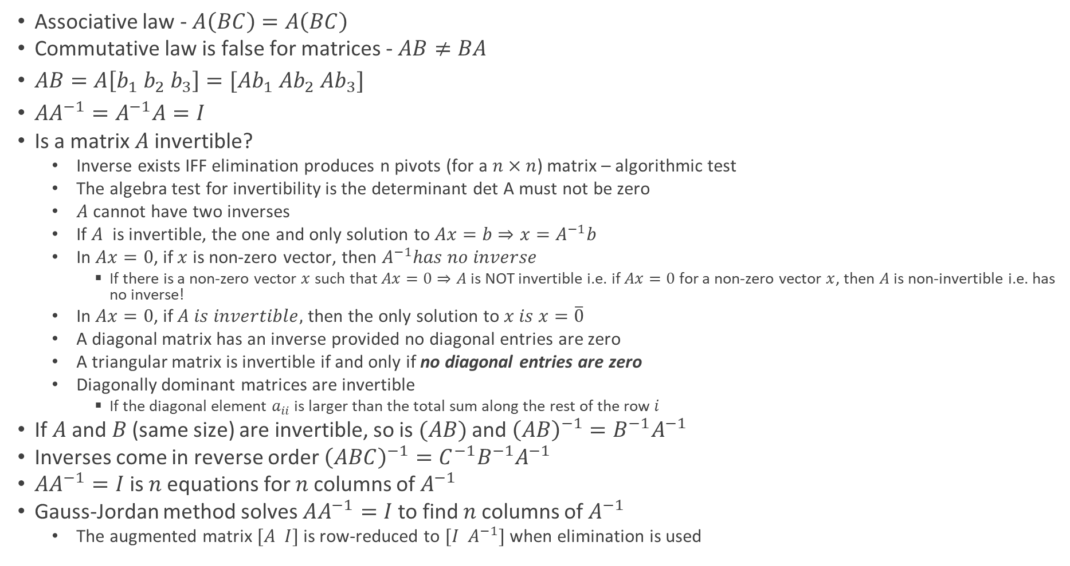
Matrix Rules
Associative law - $A\left(BC\right)=A\left(BC\right)$
Commutative law is false for matrices - $AB≠BA$
$AB=A\left[b_{1} b_{2} b_{3}\right]=[Ab_{1} Ab_{2} Ab_{3}]$
$AA^{−1}=A^{−1}A=I$
Is a matrix $A$ invertible?
Inverse exists IFF elimination produces n pivots (for a $n×n$) matrix – algorithmic test
The algebra test for invertibility is the determinant det A must not be zero
$A$ cannot have two inverses
If $A$ is invertible, the one and only solution to $Ax=b$ $⇒x=A^{−1}b$
In $Ax=0$, if $x$ is non-zero vector, then $A^{−1}has no inverse$
If there is a non-zero vector $x$ such that $Ax=0⇒A$ is NOT invertible i.e. if $Ax=0$ for a non-zero vector $x$, then $A$ is non-invertible i.e. has no inverse!
In $Ax=0$, if $A is invertible,$ then the only solution to $x is x=\overline{0}$
A diagonal matrix has an inverse provided no diagonal entries are zero
A triangular matrix is invertible if and only if no diagonal entries are zero
Diagonally dominant matrices are invertible
If the diagonal element $a_{ii}$ is larger than the total sum along the rest of the row $i$
If $A$ and$B$ (same size) are invertible, so is $(AB)$ and ${\left(AB\right)}^{−1}=B^{−1}A^{−1}$
Inverses come in reverse order ${\left(ABC\right)}^{−1}=C^{−1}B^{−1}A^{−1}$
$AA^{−1}=I$ is $n$ equations for $n$ columns of $A^{−1}$
Gauss-Jordan method solves $AA^{−1}=I$ to find $n$ columns of $A^{−1}$
The augmented matrix $[A I]$ is row-reduced to $[I A^{−1}]$ when elimination is used

Slide 23
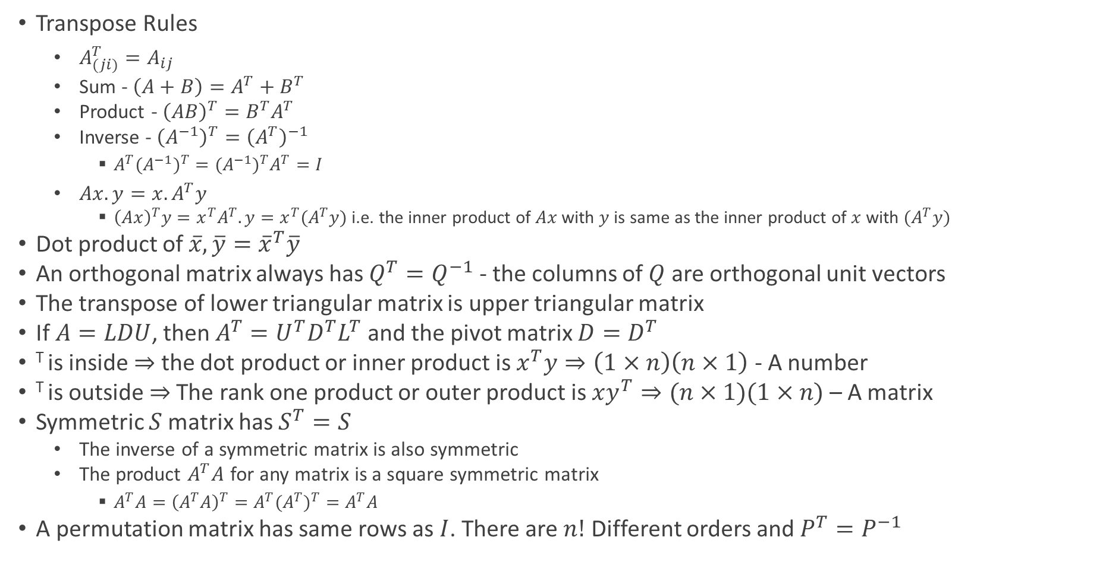
Transpose and Permutations
Transpose Rules
$A_{(ji)}^{T}=A_{ij}$
Sum - $\left(A+B\right)=A^{T}+B^{T}$
Product - ${\left(AB\right)}^{T}=B^{T}A^{T}$
Inverse - ${\left(A^{−1}\right)}^{T}={\left(A^{T}\right)}^{−1}$
$A^{T}{{(A}^{−1})}^{T}={{(A}^{−1})}^{T}A^{T}=I$
$Ax.y=x.A^{T}y$
${\left(Ax\right)}^{T}y=x^{T}A^{T}.y=x^{T}(A^{T}y)$ i.e. the inner product of $Ax$ with $y$ is same as the inner product of $x$ with $(A^{T}y)$
Dot product of $\overline{x},\overline{y}={\overline{x}}^{T}\overline{y}$
An orthogonal matrix always has $Q^{T}=Q^{−1}$ - the columns of $Q$ are orthogonal unit vectors
The transpose of lower triangular matrix is upper triangular matrix
If $A=LDU$, then $A^{T}=U^{T}D^{T}L^{T}$ and the pivot matrix $D=D^{T}$
^{T} is inside $⇒$ the dot product or inner product is $x^{T}y⇒\left(1×n\right)\left(n×1\right)$ - A number
^{T} is outside $⇒$The rank one product or outer product is $xy^{T}⇒(n×1)(1×n)$ – A matrix
Symmetric $S$matrix has $S^{T}=S$
The inverse of a symmetric matrix is also symmetric
The product $A^{T}A$ for any matrix is a square symmetric matrix
$A^{T}A={\left(A^{T}A\right)}^{T}=A^{T}{{(A}^{T})}^{T}=A^{T}A$
A permutation matrix has same rows as $I$. There are $n!$ Different orders and $P^{T}=P^{−1}$

Slide 24
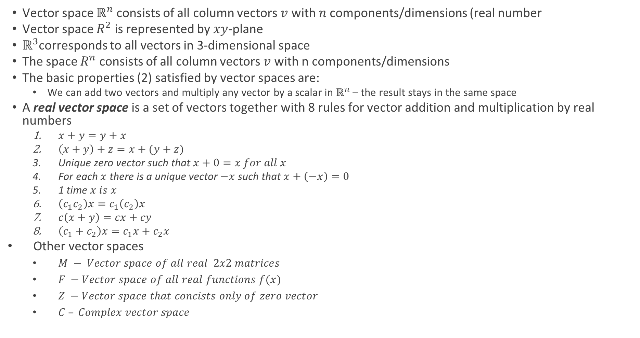
Vector Spaces
Vector space $ℝ^{n}$consists of all column vectors $v$ with $n$ components/dimensions (real number
Vector space $R^{2}$ is represented by $xy$-plane
$ℝ^{3}$corresponds to all vectors in 3-dimensional space
The space $R^{n}$ consists of all column vectors $v$ with n components/dimensions
The basic properties (2) satisfied by vector spaces are:
We can add two vectors and multiply any vector by a scalar in $ℝ^{n}$ – the result stays in the same space
A real vector space is a set of vectors together with 8 rules for vector addition and multiplication by real numbers
$x+y=y+x$
$\left(x+y\right)+z=x+(y+z)$
Unique zero vector such that $x+0=x for all x$
For each $x$ there is a unique vector $−x$ such that $x+\left(−x\right)=0$
1 time $x is x$
$\left(c_{1}c_{2}\right)x=c_{1}\left(c_{2}\right)x$
$c\left(x+y\right)=cx+cy$
$\left(c_{1}+c_{2}\right)x=c_{1}x+c_{2}x$
Other vector spaces
$M − Vector space of all real 2x2 matrices$
$F −Vector space of all real functions f(x)$
$Z −Vector space that concists only of zero vector$
$C – Complex vector space$

Slide 25
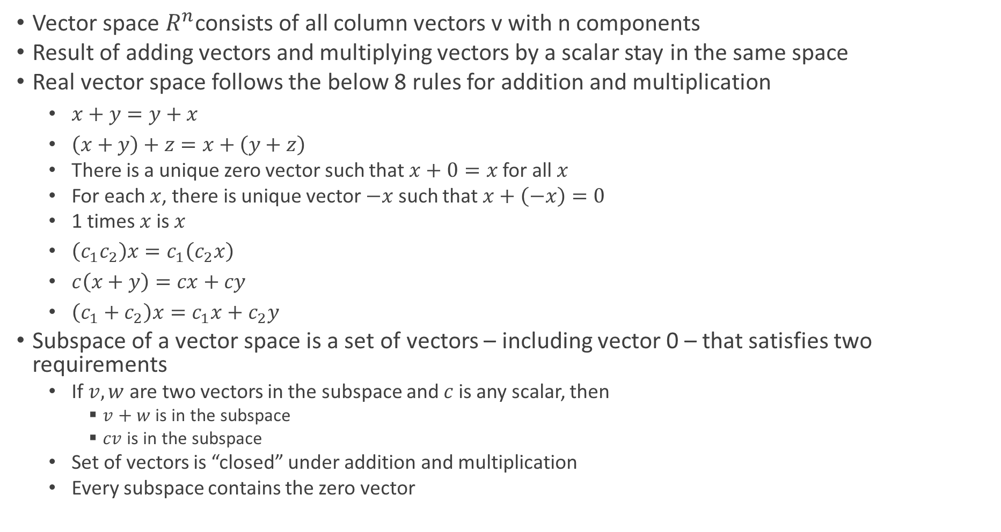
Vector Spaces
Vector space $R^{n}$consists of all column vectors v with n components
Result of adding vectors and multiplying vectors by a scalar stay in the same space
Real vector space follows the below 8 rules for addition and multiplication
$x+y=y+x$
$\left(x+y\right)+z=x+\left(y+z\right)$
There is a unique zero vector such that $x+0=x$ for all $x$
For each $x$, there is unique vector $−x$ such that $x+\left(−x\right)=0$
1 times $x$ is $x$
$\left(c_{1}c_{2}\right)x=c_{1}\left(c_{2}x\right)$
$c\left(x+y\right)=cx+cy$
$\left(c_{1}+c_{2}\right)x=c_{1}x+c_{2}y$
Subspace of a vector space is a set of vectors – including vector 0 – that satisfies two requirements
If $v,w$ are two vectors in the subspace and $c$ is any scalar, then
$v+w$ is in the subspace
$cv$ is in the subspace
Set of vectors is “closed” under addition and multiplication
Every subspace contains the zero vector

Slide 26
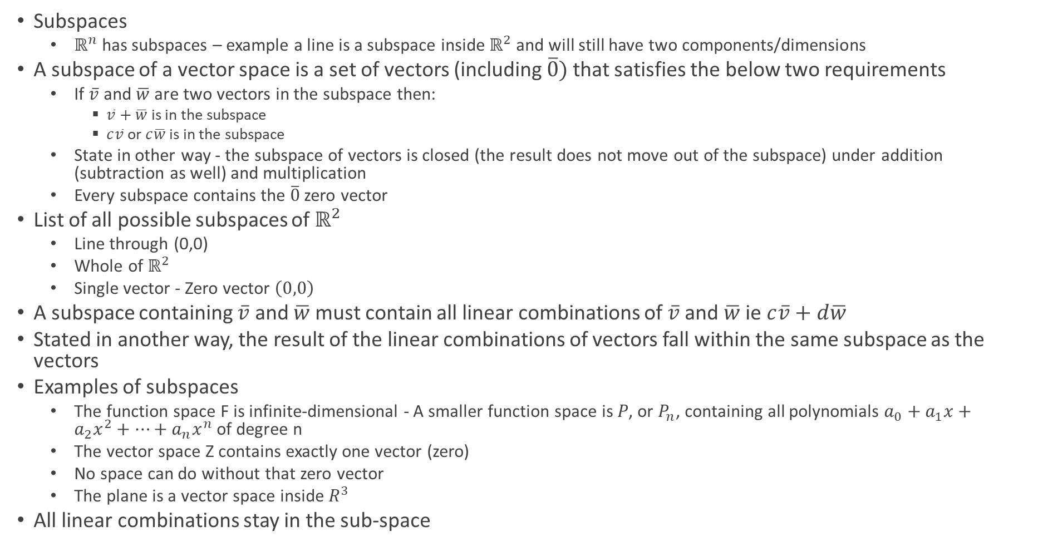
Vector Spaces
Subspaces
$ℝ^{n}$ has subspaces – example a line is a subspace inside $ℝ^{2}$ and will still have two components/dimensions
A subspace of a vector space is a set of vectors (including $\overline{0})$ that satisfies the below two requirements
If $\overline{v}$ and $\overline{w}$ are two vectors in the subspace then:
$\overline{v}+\overline{w}$ is in the subspace
$c\overline{v}$ or $c\overline{w}$ is in the subspace
State in other way - the subspace of vectors is closed (the result does not move out of the subspace) under addition (subtraction as well) and multiplication
Every subspace contains the $\overline{0}$ zero vector
List of all possible subspaces of $ℝ^{2}$
Line through (0,0)
Whole of $ℝ^{2}$
Single vector - Zero vector $\left(0,0\right)$
A subspace containing $\overline{v}$ and $\overline{w}$ must contain all linear combinations of $\overline{v}$ and $\overline{w}$ ie $c\overline{v}+d\overline{w}$
Stated in another way, the result of the linear combinations of vectors fall within the same subspace as the vectors
Examples of subspaces
The function space F is infinite-dimensional - A smaller function space is 𝑃, or $P_{n}$, containing all polynomials $a_{0}+a_{1}x+a_{2}x^{2}+…+a_{n}x^{n}$of degree n
The vector space Z contains exactly one vector (zero)
No space can do without that zero vector
The plane is a vector space inside $R^{3}$
All linear combinations stay in the sub-space

Slide 27
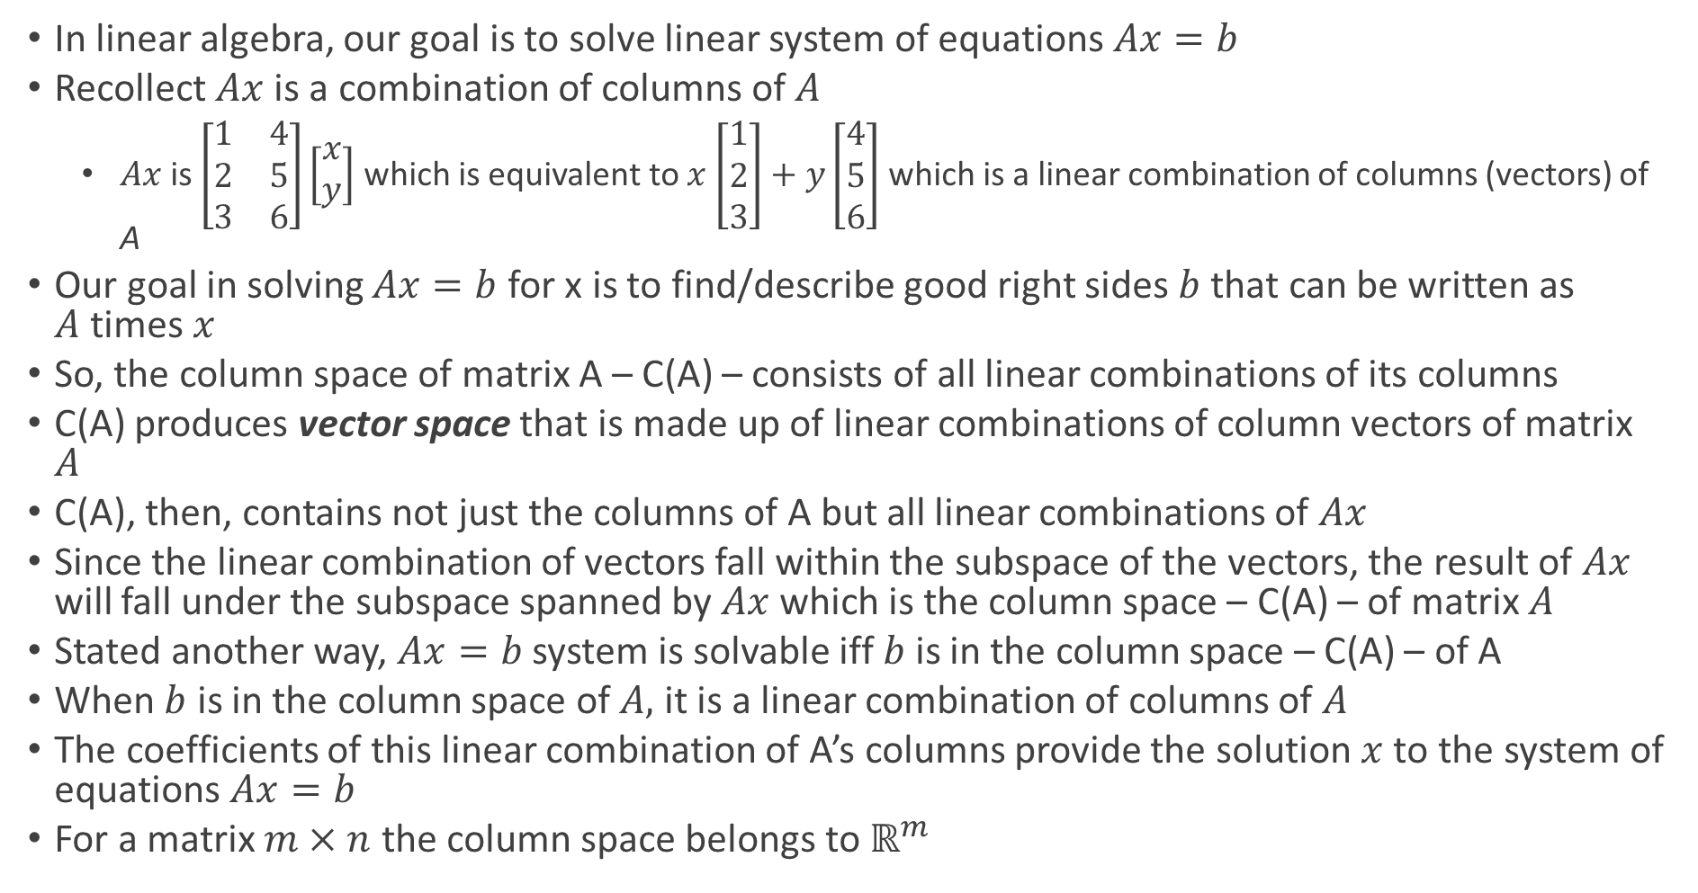
Column Space of Matrix A
In linear algebra, our goal is to solve linear system of equations $Ax=b$
Recollect $Ax$ is a combination of columns of $A$
$Ax$ is $\left[\begin{matrix}1 & 4 \\ 2 & 5 \\ 3 & 6\end{matrix}\right]\left[\begin{matrix}x \\ y\end{matrix}\right]$ which is equivalent to $x$ $\left[\begin{matrix}1 \\ 2 \\ 3\end{matrix}\right]+y\left[\begin{matrix}4 \\ 5 \\ 6\end{matrix}\right]$ which is a linear combination of columns (vectors) of A
Our goal in solving $Ax=b$ for x is to find/describe good right sides $b$ that can be written as $A$times $x$
So, the column space of matrix A – C(A) – consists of all linear combinations of its columns
C(A) produces vector space that is made up of linear combinations of column vectors of matrix $A$
C(A), then, contains not just the columns of A but all linear combinations of $Ax$
Since the linear combination of vectors fall within the subspace of the vectors, the result of $Ax$ will fall under the subspace spanned by $Ax$ which is the column space – C(A) – of matrix $A$
Stated another way, $Ax=b$ system is solvable iff $b$is in the column space – C(A) – of A
When $b$ is in the column space of $A,$ it is a linear combination of columns of $A$
The coefficients of this linear combination of A’s columns provide the solution $x$ to the system of equations $Ax=b$
For a matrix $m×n$ the column space belongs to $ℝ^{m}$

Slide 28
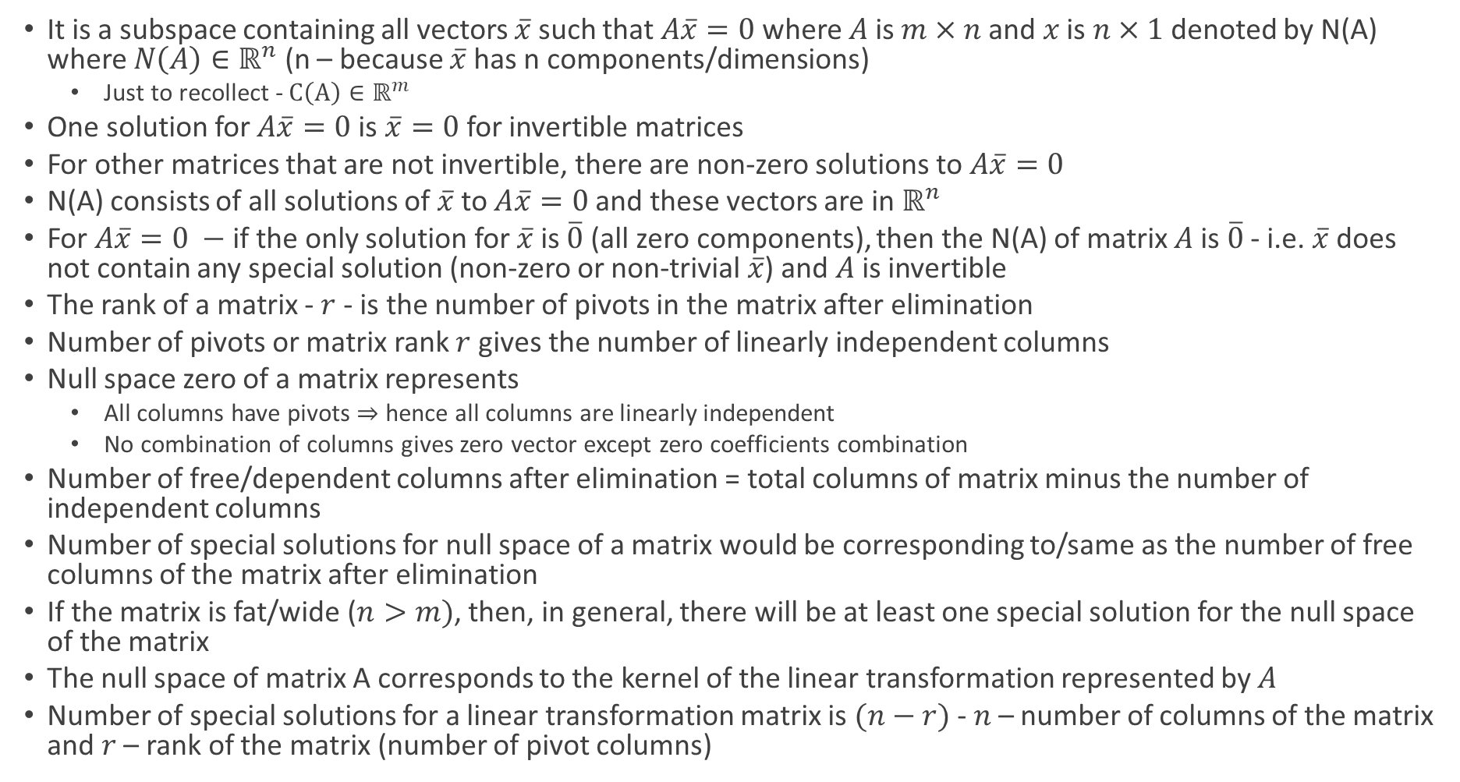
Null Space of Matrix A
It is a subspace containing all vectors $\overline{x}$ such that$A\overline{x}=0$ where $A$ is $m×n$ and $x$ is $n×1$ denoted by N(A) where $N\left(A\right)∈ℝ^{n}$ (n – because $\overline{x}$ has n components/dimensions)
Just to recollect - $C\left(A\right)∈ℝ^{m}$
One solution for $A\overline{x}=0$ is $\overline{x}=0$ for invertible matrices
For other matrices that are not invertible, there are non-zero solutions to $A\overline{x}=0$
N(A) consists of all solutions of $\overline{x}$ to $A\overline{x}=0$ and these vectors are in $ℝ^{n}$
For $A\overline{x}=0 −$if the only solution for $\overline{x}$ is $\overline{0}$ (all zero components), then the N(A) of matrix $A$is $\overline{0}$ - i.e. $\overline{x}$ does not contain any special solution (non-zero or non-trivial $\overline{x}$) and $A$ is invertible
The rank of a matrix - $r$ - is the number of pivots in the matrix after elimination
Number of pivots or matrix rank $r$ gives the number of linearly independent columns
Null space zero of a matrix represents
All columns have pivots $⇒$ hence all columns are linearly independent
No combination of columns gives zero vector except zero coefficients combination
Number of free/dependent columns after elimination = total columns of matrix minus the number of independent columns
Number of special solutions for null space of a matrix would be corresponding to/same as the number of free columns of the matrix after elimination
If the matrix is fat/wide ($n>m)$, then, in general, there will be at least one special solution for the null space of the matrix
The null space of matrix A corresponds to the kernel of the linear transformation represented by $A$
Number of special solutions for a linear transformation matrix is $(n−r)$ - $n$ – number of columns of the matrix and $r$ – rank of the matrix (number of pivot columns)

Slide 29
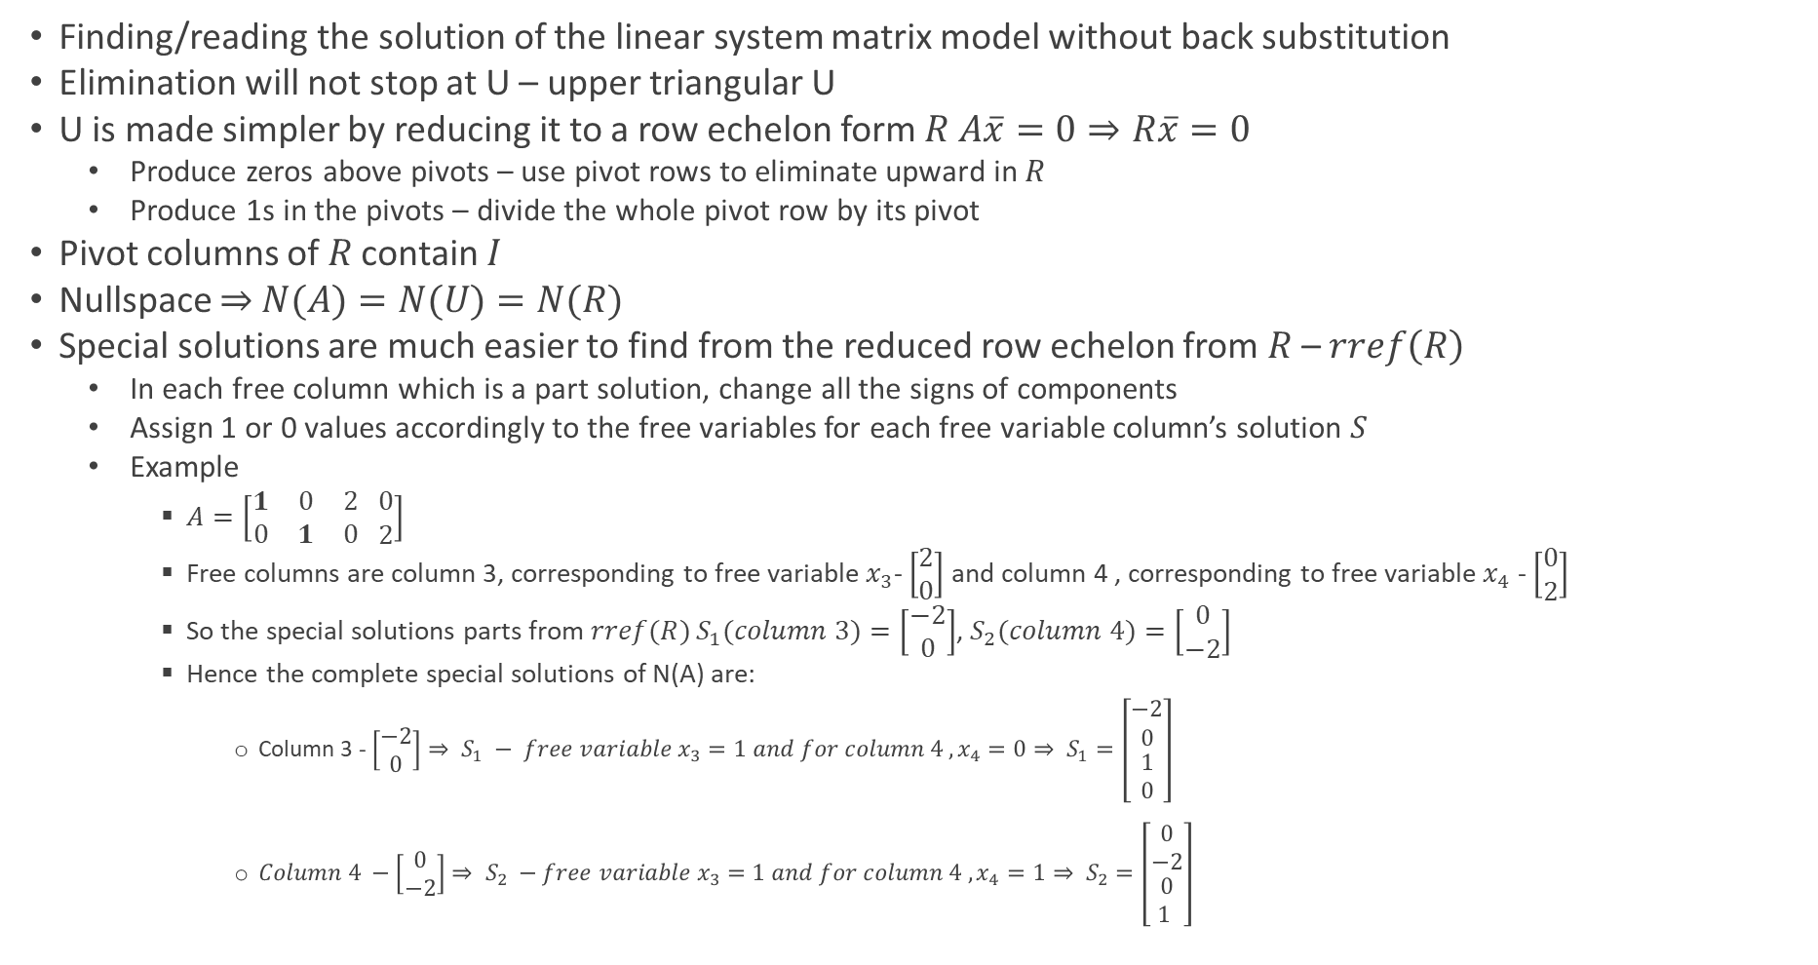
Reduced Row Echelon Form R
Finding/reading the solution of the linear system matrix model without back substitution
Elimination will not stop at U – upper triangular U
U is made simpler by reducing it to a row echelon form $R$ $A\overline{x}=0⇒R\overline{x}=0$
Produce zeros above pivots – use pivot rows to eliminate upward in $R$
Produce 1s in the pivots – divide the whole pivot row by its pivot
Pivot columns of $R$ contain $I$
Nullspace $⇒$ $N(A)=N(U)=N(R)$
Special solutions are much easier to find from the reduced row echelon from $R$ – $rref\left(R\right)$
In each free column which is a part solution, change all the signs of components
Assign 1 or 0 values accordingly to the free variables for each free variable column’s solution $S$
Example
$A=\left[\begin{matrix}1 & 0 & 2 \\ 0 & 1 & 0\end{matrix} \begin{matrix}0 \\ 2\end{matrix}\right]$
Free columns are column 3, corresponding to free variable $x_{3}$- $\left[\begin{matrix}2 \\ 0\end{matrix}\right]$ and column 4 , corresponding to free variable $x_{4}$ - $\left[\begin{matrix}0 \\ 2\end{matrix}\right]$
So the special solutions parts from $rref(R)$ $S_{1}(column 3)=\left[\begin{matrix}−2 \\ 0\end{matrix}\right]$, $S_{2}(column 4)=\left[\begin{matrix}0 \\ −2\end{matrix}\right]$
Hence the complete special solutions of N(A) are:
Column 3 - $\left[\begin{matrix}−2 \\ 0\end{matrix}\right]⇒ S_{1} − free variable x_{3}=1 and for column 4 , x_{4}=0⇒ S_{1}=\left[\begin{matrix}−2 \\ 0 \\ \begin{aligned}1 \\ 0\end{aligned}\end{matrix}\right]$
${Column 4 −\left[\begin{matrix}0 \\ −2\end{matrix}\right]⇒ S}_{2} −free variable x_{3}=1 and for column 4 , x_{4}=1⇒ S_{2}=\left[\begin{matrix}0 \\ −2 \\ \begin{aligned}0 \\ 1 \end{aligned}\end{matrix}\right]$

Slide 30
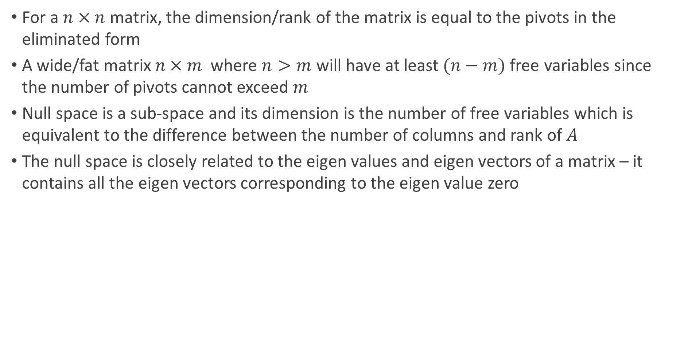
Dimensionality of Null space
For a $n×n$ matrix, the dimension/rank of the matrix is equal to the pivots in the eliminated form
A wide/fat matrix $n×m$ where $n>m$ will have at least $(n−m)$ free variables since the number of pivots cannot exceed $m$
Null space is a sub-space and its dimension is the number of free variables which is equivalent to the difference between the number of columns and rank of $A$
The null space is closely related to the eigen values and eigen vectors of a matrix – it contains all the eigen vectors corresponding to the eigen value zero

Slide 31
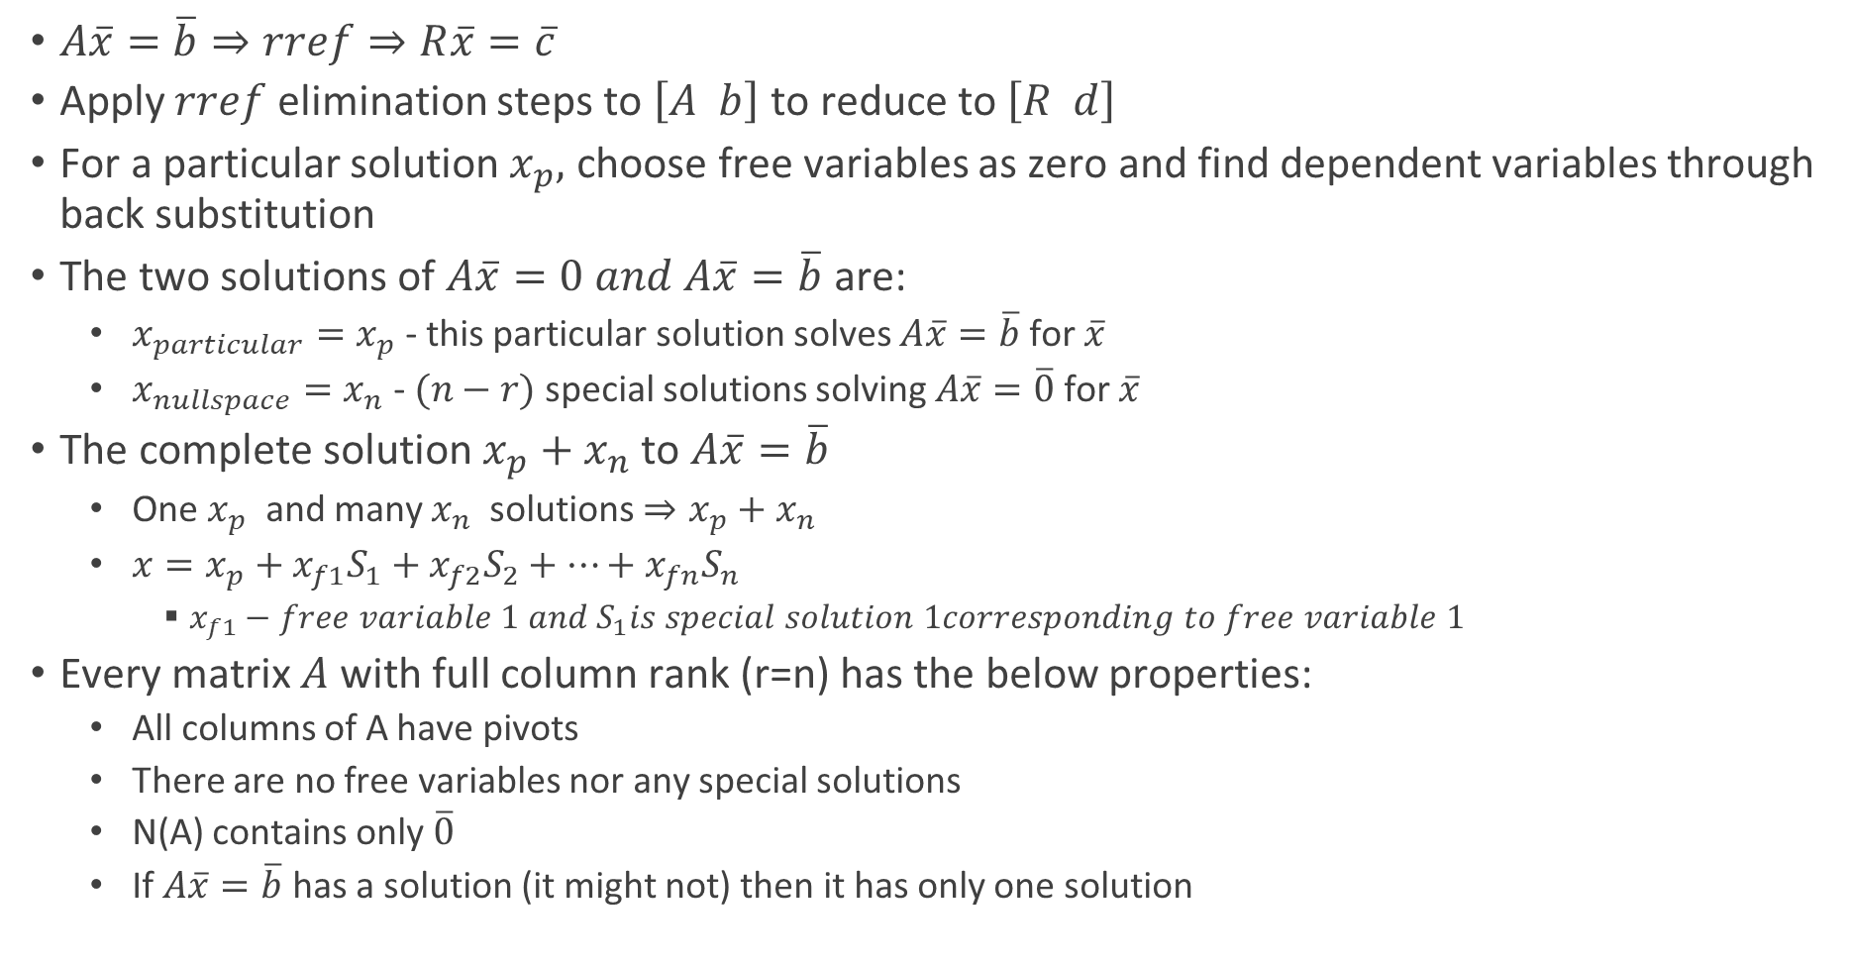
Complete Solution to $A\overline{x}=\overline{b}$
$A\overline{x}=\overline{b}⇒rref⇒R\overline{x}=\overline{c}$
Apply $rref$ elimination steps to $\left[A b\right]$ to reduce to$\left[R d\right]$
For a particular solution $x_{p},$ choose free variables as zero and find dependent variables through back substitution
The two solutions of $A\overline{x}=0 and A\overline{x}=\overline{b}$ are:
$x_{particular}=x_{p}$ - this particular solution solves $A\overline{x}=\overline{b}$ for $\overline{x}$
$x_{nullspace}=x_{n}$ - $(n−r)$ special solutions solving $A\overline{x}=\overline{0}$ for $\overline{x}$
The complete solution $x_{p}+x_{n}$ to $A\overline{x}=\overline{b}$
One $x_{p}$ and many $x_{n}$ solutions $⇒x_{p}+x_{n}$
$x=x_{p}+x_{f1}S_{1}+x_{f2}S_{2}+…+x_{fn}S_{n}$
$x_{f1}−free variable 1 and S_{1}is special solution 1corresponding to free variable 1$
Every matrix $A$ with full column rank (r=n) has the below properties:
All columns of A have pivots
There are no free variables nor any special solutions
N(A) contains only $\overline{0}$
If $A\overline{x}=\overline{b}$ has a solution (it might not) then it has only one solution

Slide 32

Inner Product
Dot/inner product of $x$ and $y$ is the sum of numbers $x_{i}y_{i}=x^{T}y$
If A is symmetric, $S^{T}=S$

Slide 33
Solving Linear Equations
System way to solve linear equations – “Gaussian Elimination”
First non-zero coefficient in the row that does the elimination is pivot
Pivots must be non-zero as we have to divide by them
Multiplier – (entry to eliminate)/(pivot)
Singular – there is no second pivot
Have no solution or infinitely many solutions
Non-singular – full set of pivots and exactly one solution

Slide 34

Lecture 7
Matrix rules
When a matrix has $m$ rows and $n$ columns it is a $m$x$n$ matrix

Slide 35
Finding If b is in Column Space of A in Ax=b
If we want to check whether a given vector b is in the column space of a matrix A, we need to find the reduced row echelon form of the augmented matrix [A | b]
Perform the following steps:
Augment matrix A with vector b to form [A | b]
Find the reduced row echelon form of [A | b]
If the reduced row echelon form of [A | b] has a row of zeros followed by a non-zero number in the last column
Then b is not in the column space of A
Otherwise, b is in the column space of A

Slide 36
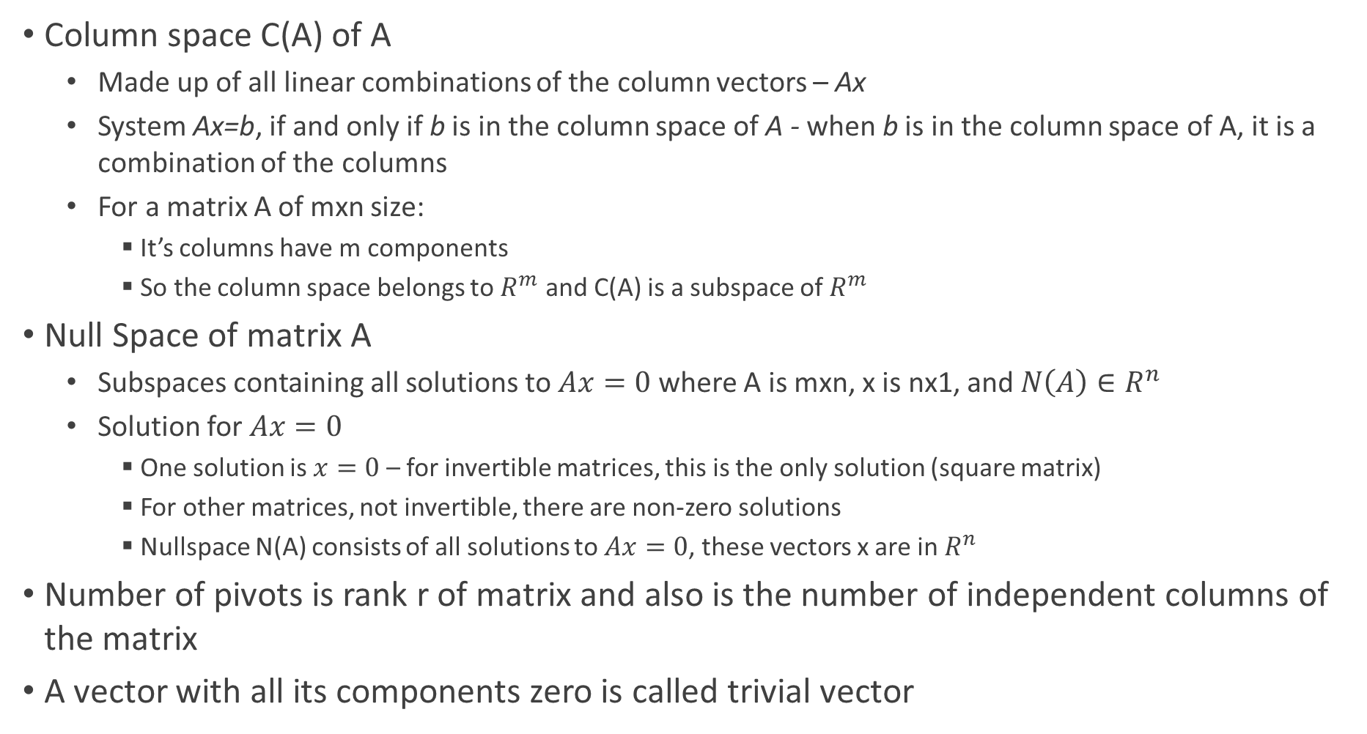
Spaces of A Matrix
Column space C(A) of A
Made up of all linear combinations of the column vectors – Ax
System Ax=b, if and only if b is in the column space of A - when b is in the column space of A, it is a combination of the columns
For a matrix A of mxn size:
It’s columns have m components
So the column space belongs to $R^{m}$ and C(A) is a subspace of $R^{m}$
Null Space of matrix A
Subspaces containing all solutions to $Ax=0$ where A is mxn, x is nx1, and $N\left(A\right)∈R^{n}$
Solution for $Ax=0$
One solution is $x=0$ – for invertible matrices, this is the only solution (square matrix)
For other matrices, not invertible, there are non-zero solutions
Nullspace N(A) consists of all solutions to $Ax=0$, these vectors x are in $R^{n}$
Number of pivots is rank r of matrix and also is the number of independent columns of the matrix
A vector with all its components zero is called trivial vector

Slide 37
Spaces of A Matrix
Importance of null space of a matrix
It says that all columns have pivots and are independent
No combination of columns gives a zero vector – except zero combination
Number of free columns (non-pivot columns) tell us the number of special solutions for Ax=0
Number of special solutions will be same as number of free columns
This is possible when in the matrix size of mxn n>m

Slide 38

Matrix Column Space and Span
The column space of a matrix is the set of all possible linear combinations of its columns – in other words, it is the span of the columns of the matrix
To find the span of the column space
Perform RREF on the matrix
Identify the pivot columns – these are linearly independent columns
The span of the column space is then the set of all linear combinations of the pivot columns
The span of the column space of an m x n matrix is a subspace of $R^{m}$

Slide 39
Reduced Row Echelon Form - RREF
Method to transform a matrix into a simpler and more compact form
The process involves performing a series of elementary row operations on the matrix until the below two conditions are satisfied:
All rows containing only zeros are at the bottom of the matrix
The first non-zero element – called pivot – in each row is a 1 and it is the only non-zero element in its column
A leading 1 in a column is the first non-zero entry in that column, which is directly below the leading 1 of the row above it
The free variables correspond to the columns in which there is no leading 1
In this form, the pivot elements form a diagonal from the upper left corner to the lower right corner, and all elements above and below the pivot elements are zero
Use row operations to make all other entries below the pivot zero
The RREF matrix has the following properties
All rows with only zero entries are at the bottom of the matrix
The first non-zero entry (pivot) of each non-zero row is 1
The pivots appear in increasingly higher columns from top to bottom
All entries above and below each pivot are zero

Slide 40
Reduced Row Echelon Form - RREF
Reduced row echelon form (RREF) is a matrix that has been transformed using a series of row operations, resulting in a matrix that has certain properties. Specifically, a matrix is in reduced row echelon form if it satisfies the following conditions:
All rows containing only zeros are at the bottom of the matrix
The first nonzero entry (also called a pivot) in each row is 1
Each pivot is to the right of the pivot in the row above it
If a column contains a pivot, then all other entries in that column are zeros
To put a matrix into reduced row echelon form, we can use a series of row operations, including:
Interchange any two rows
Multiply a row by a nonzero constant
Add a multiple of one row to another row
The process of putting a matrix into reduced row echelon form is called row reduction or Gaussian elimination
This process is used in many areas of mathematics, including linear algebra, differential equations, and numerical analysis
The reduced row echelon form is useful
For solving linear systems of equations
Finding the rank of a matrix
The number of non-zero rows in the RREF of a matrix is the rank of the matrix
Rank of a matrix is equal to the dimension of the column space of the matrix which is the span of the columns of the matrix
It is also equal to the dimension of the row space of the matrix, which is the span of the rows of the matrix
Computing inverse
Create augmented matrix [A |I]
Perform RREF operations on [A |I] to obtain a matrix in the form [I |B] where B is the inverse of A
Computing determinant

Slide 41
Reduced Row Echelon Form R
Create upper triangle matrix U by reduction
Produce zeros above pivots
Produce ones in pivots

Slide 42
Dimensionality of Nullspace of a Matrix
If matrix A has more columns than rows (n>m)
Must have at least (n-m) free variables since the number of pivots cannot exceed m – also (n-m) special solutions
A row never has more than 1 pivot
Nullspace is a subspace and its dimension is the number of free variables

Slide 43
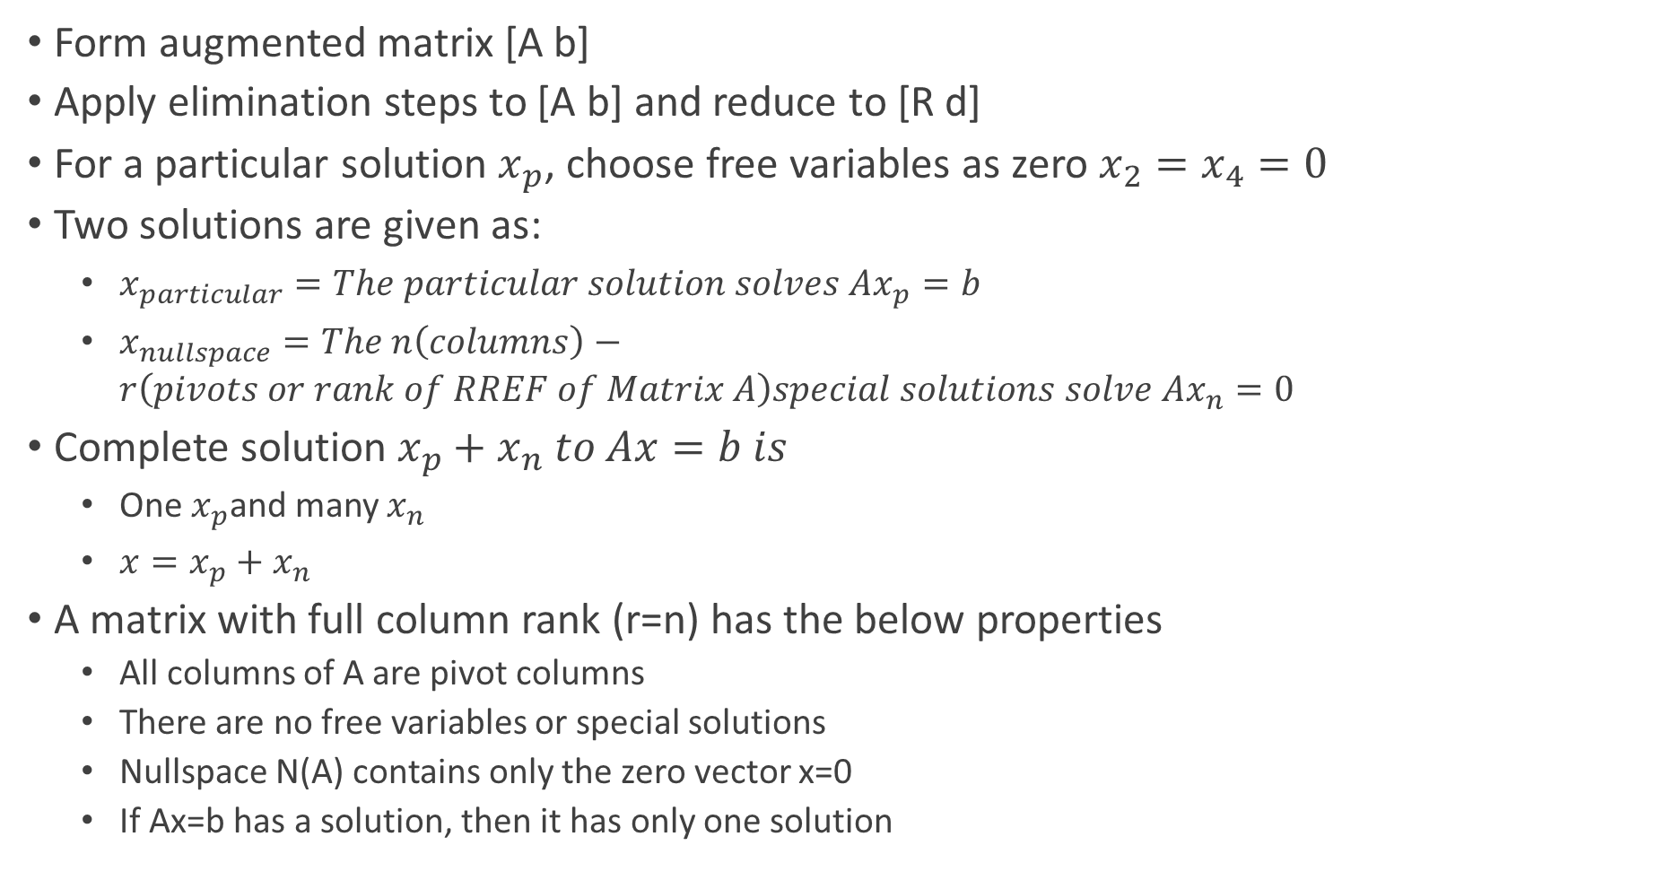
Finding Solution for Ax=b
Form augmented matrix [A b]
Apply elimination steps to [A b] and reduce to [R d]
For a particular solution $x_{p}$, choose free variables as zero $x_{2}=x_{4}=0$
Two solutions are given as:
$x_{particular}=The particular solution solves Ax_{p}=b$
$x_{nullspace}=The n\left(columns\right)−r\left(pivots or rank of RREF of Matrix A\right)special solutions solve Ax_{n}=0$
Complete solution $x_{p}+x_{n} to Ax=b is$
One $x_{p}$and many $x_{n}$
$x=x_{p}+x_{n}$
A matrix with full column rank (r=n) has the below properties
All columns of A are pivot columns
There are no free variables or special solutions
Nullspace N(A) contains only the zero vector x=0
If Ax=b has a solution, then it has only one solution

Slide 44
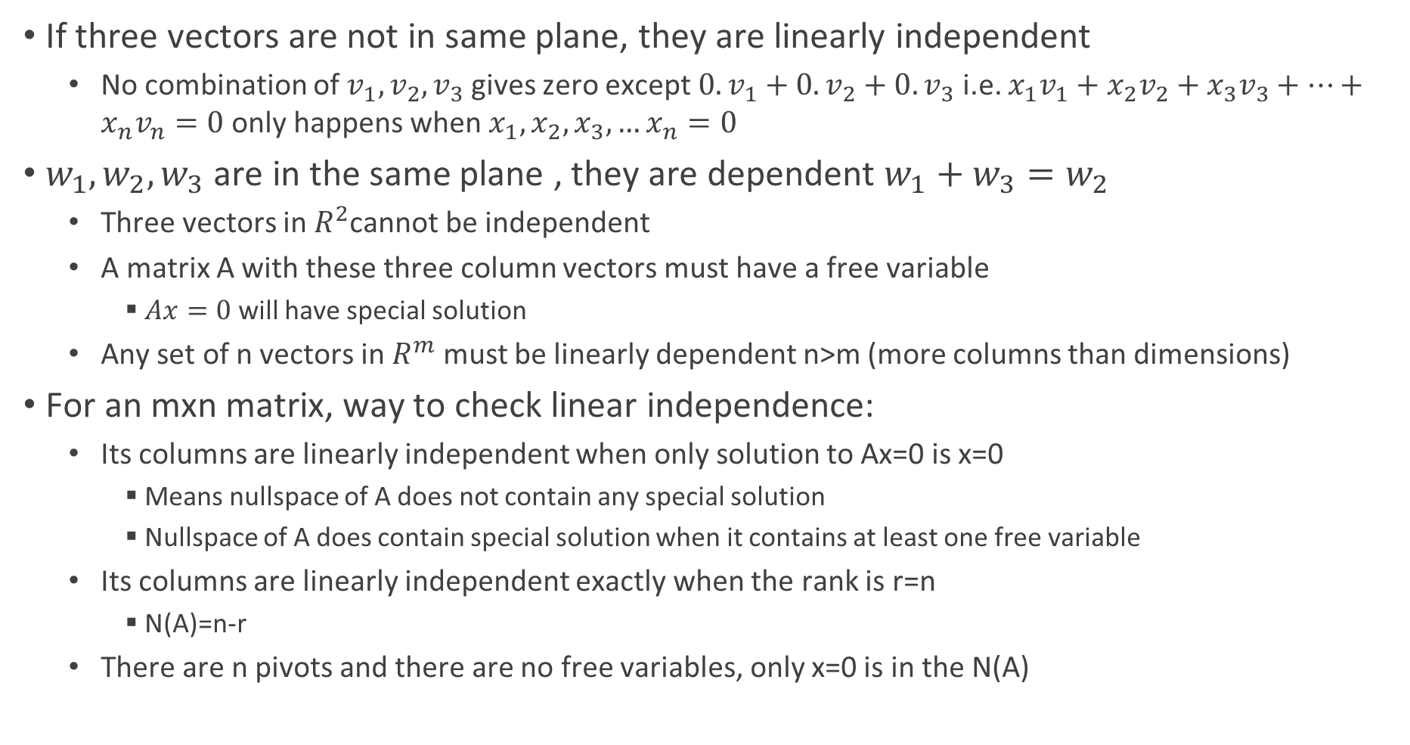
Linear Independence, Column Space, and Row Spaces
If three vectors are not in same plane, they are linearly independent
No combination of $v_{1}, v_{2}, v_{3}$ gives zero except $0.v_{1}+0.v_{2}+0.v_{3}$ i.e. $x_{1}v_{1}+x_{2}v_{2}+x_{3}v_{3}+…+x_{n}v_{n}=0$ only happens when $x_{1},x_{2},x_{3},…x_{n}=0$
$w_{1},w_{2},w_{3}$ are in the same plane , they are dependent $w_{1}+w_{3}=w_{2}$
Three vectors in $R^{2}$cannot be independent
A matrix A with these three column vectors must have a free variable
$Ax=0$ will have special solution
Any set of n vectors in $R^{m}$ must be linearly dependent n>m (more columns than dimensions)
For an mxn matrix, way to check linear independence:
Its columns are linearly independent when only solution to Ax=0 is x=0
Means nullspace of A does not contain any special solution
Nullspace of A does contain special solution when it contains at least one free variable
Its columns are linearly independent exactly when the rank is r=n
N(A)=n-r
There are n pivots and there are no free variables, only x=0 is in the N(A)

Slide 45
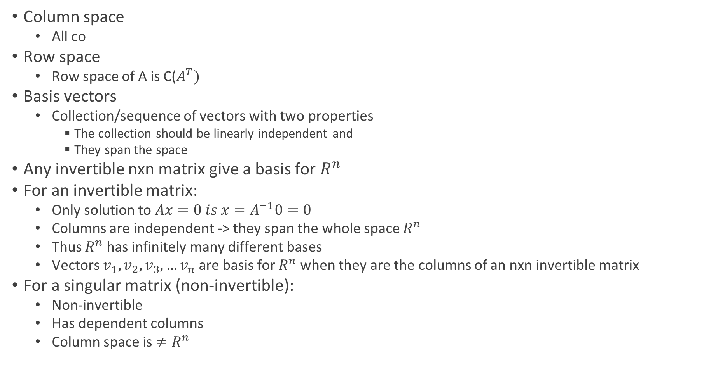
Vectors Spanning Subspace
Column space
All co
Row space
Row space of A is C($A^{T})$
Basis vectors
Collection/sequence of vectors with two properties
The collection should be linearly independent and
They span the space
Any invertible nxn matrix give a basis for $R^{n}$
For an invertible matrix:
Only solution to $Ax=0 is x=A^{−1}0=0$
Columns are independent -> they span the whole space $R^{n}$
Thus $R^{n}$ has infinitely many different bases
Vectors $v_{1},v_{2},v_{3},…v_{n}$ are basis for $R^{n}$ when they are the columns of an nxn invertible matrix
For a singular matrix (non-invertible):
Non-invertible
Has dependent columns
Column space is $≠R^{n}$

Slide 46
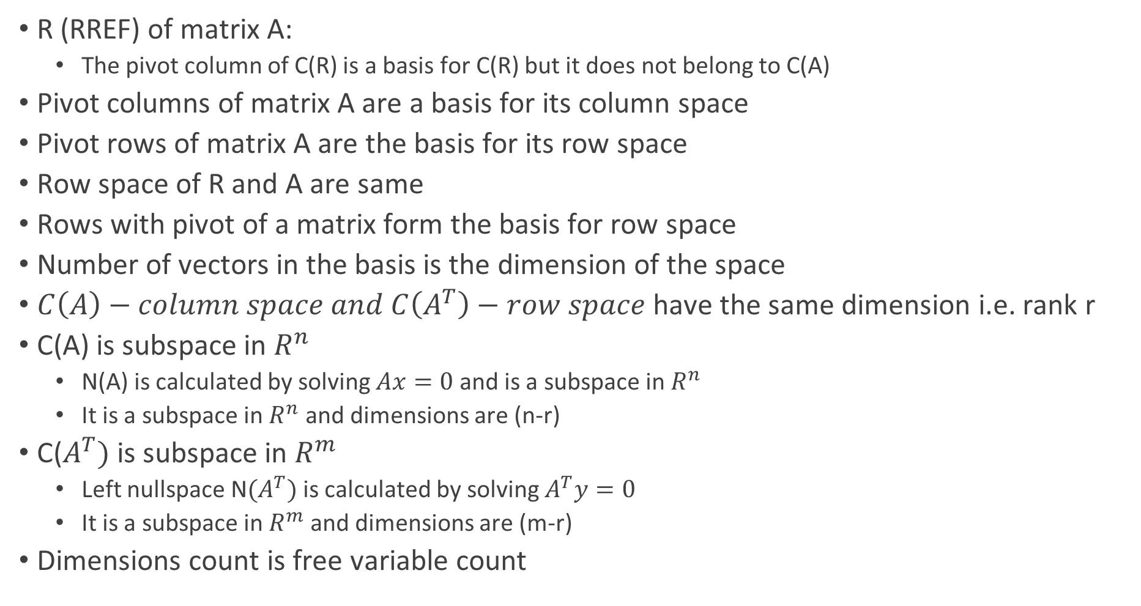
Finding Basis Vectors
R (RREF) of matrix A:
The pivot column of C(R) is a basis for C(R) but it does not belong to C(A)
Pivot columns of matrix A are a basis for its column space
Pivot rows of matrix A are the basis for its row space
Row space of R and A are same
Rows with pivot of a matrix form the basis for row space
Number of vectors in the basis is the dimension of the space
$C\left(A\right)−column space and C\left(A^{T}\right)−row space$ have the same dimension i.e. rank r
C(A) is subspace in $R^{n}$
N(A) is calculated by solving $Ax=0$ and is a subspace in $R^{n}$
It is a subspace in $R^{n}$ and dimensions are (n-r)
C($A^{T})$ is subspace in $R^{m}$
Left nullspace N${(A}^{T})$ is calculated by solving $A^{T}y=0$
It is a subspace in $R^{m}$ and dimensions are (m-r)
Dimensions count is free variable count

Slide 47
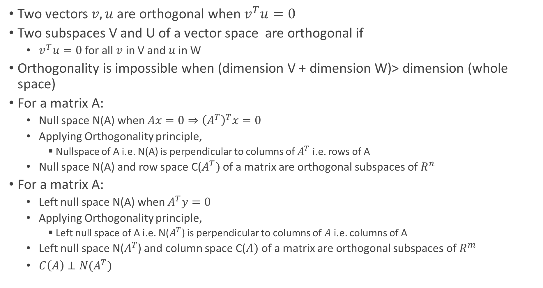
Orthogonal Subspaces
Two vectors $v,u$ are orthogonal when $v^{T}u=0$
Two subspaces V and U of a vector space are orthogonal if
$v^{T}u=0$ for all $v$ in V and $u$in W
Orthogonality is impossible when (dimension V + dimension W)> dimension (whole space)
For a matrix A:
Null space N(A) when $Ax=0⇒{\left(A^{T}\right)}^{T}x=0$
Applying Orthogonality principle,
Nullspace of A i.e. N(A) is perpendicular to columns of $A^{T}$ i.e. rows of A
Null space N(A) and row space C($A^{T})$ of a matrix are orthogonal subspaces of $R^{n}$
For a matrix A:
Left null space N(A) when $A^{T}y=0$
Applying Orthogonality principle,
Left null space of A i.e. N($A^{T}$) is perpendicular to columns of $A$ i.e. columns of A
Left null space N($A^{T}$) and column space C($A)$ of a matrix are orthogonal subspaces of $R^{m}$
$C\left(A\right)⊥N(A^{T})$

Slide 48

Orthogonal Subspaces
Orthogonal complement of a subspace V
Contains every vector that is perpendicular to V and denoted by $V^{⊥}$
Null space N(A) is the orthogonal complement of the row space of A
Let null space N($A^{T}$) is the orthogonal complement of the column space of A

Slide 49
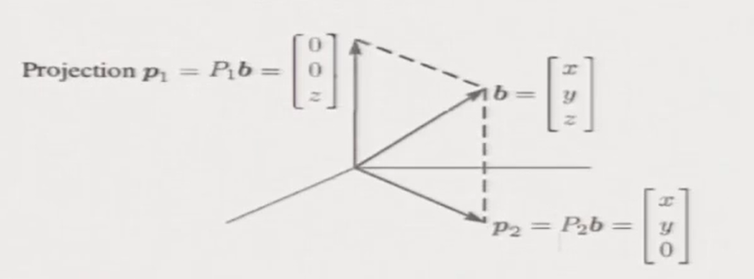
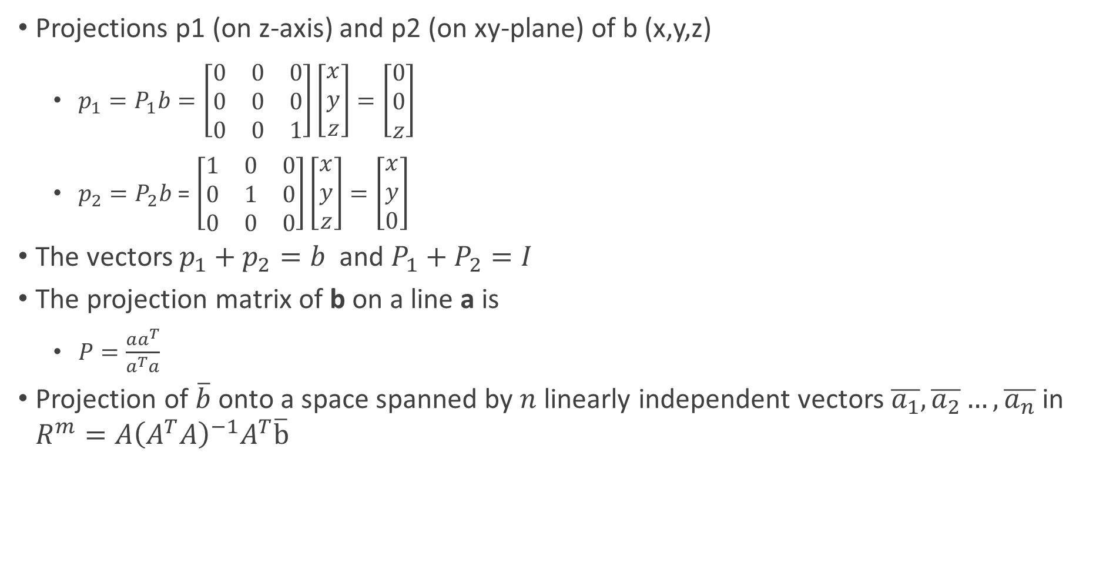
Projections
Projections p1 (on z-axis) and p2 (on xy-plane) of b (x,y,z)
$p_{1}=P_{1}b=\left[\begin{matrix}0 & 0 & 0 \\ 0 & 0 & 0 \\ 0 & 0 & 1\end{matrix}\right]\left[\begin{matrix}x \\ y \\ z\end{matrix}\right]=\left[\begin{matrix}0 \\ 0 \\ z\end{matrix}\right]$
$p_{2}=P_{2}b$ = $\left[\begin{matrix}1 & 0 & 0 \\ 0 & 1 & 0 \\ 0 & 0 & 0\end{matrix}\right]\left[\begin{matrix}x \\ y \\ z\end{matrix}\right]=\left[\begin{matrix}x \\ y \\ 0\end{matrix}\right]$
The vectors $p_{1}+p_{2}=b$ and $P_{1}+P_{2}=I$
The projection matrix of b on a line a is
$P=\frac{aa^{T}}{a^{T}a}$
Projection of $\overline{b}$ onto a space spanned by $n$ linearly independent vectors$\overline{a_{1}},\overline{a_{2}}…,\overline{a_{n}}$ in $R^{m}=A{\left(A^{T}A\right)}^{−1}A^{T}\overline{b}$

Slide 50
Least Squares

Slide 51
Orthonormal Matrices

Slide 52

Determinants
The determinant of product of two matrices is the individual of product of determinant of individual matrix – for square matrices
In general, the determinant of the product of more than two matrices is not equal to the product of their determinants
When A is invertible, determinant of $A^{−1}$ is $\frac{1}{\det\left(A\right)}$

Slide 53
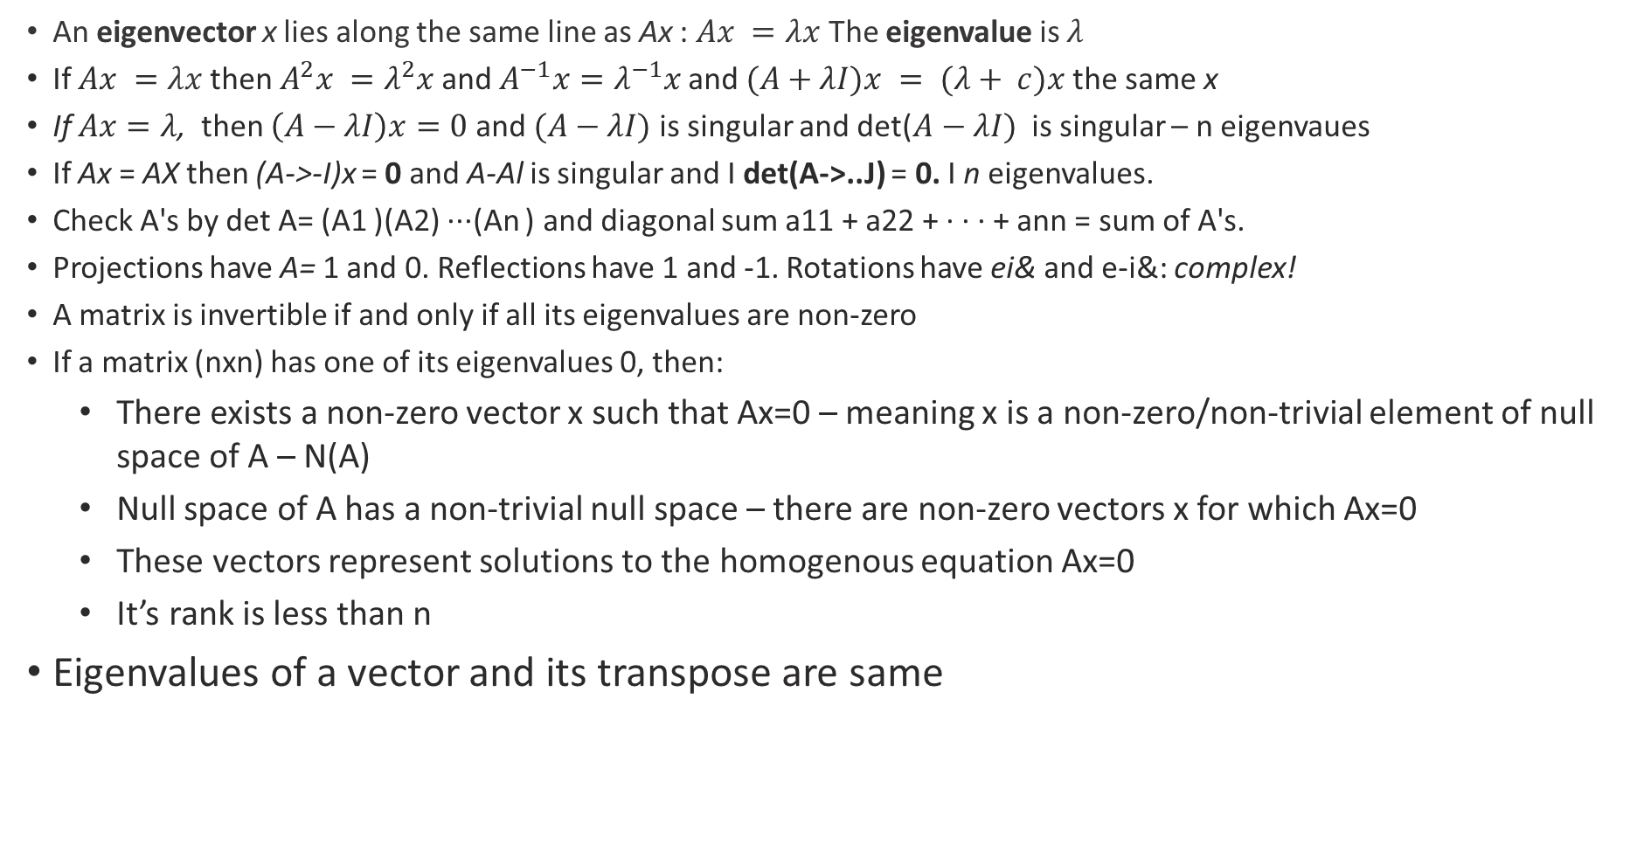
Eigenvalues and Eigenvectors
An eigenvector x lies along the same line as Ax : $Ax =λx$ The eigenvalue is $λ$
If $Ax =λx$then $A^{2}x =λ^{2}x$and $A^{−1}x=λ^{−1}x$and $(A+λI)x = (λ+ c)x$the same x
If $Ax=λ$, then $\left(A−λI\right)x=0$ and $(A−λI)$ is singular and det($A−λI)$ is singular – n eigenvaues
If Ax = AX then (A->-I)x = 0 and A-Al is singular and I det(A->..J) = 0. I n eigenvalues.
Check A's by det A= (A1 )(A2) ···(An ) and diagonal sum a11 + a22 + · · · + ann = sum of A's.
Projections have A= 1 and 0. Reflections have 1 and -1. Rotations have ei& and e-i&: complex!
A matrix is invertible if and only if all its eigenvalues are non-zero
If a matrix (nxn) has one of its eigenvalues 0, then:
There exists a non-zero vector x such that Ax=0 – meaning x is a non-zero/non-trivial element of null space of A – N(A)
Null space of A has a non-trivial null space – there are non-zero vectors x for which Ax=0
These vectors represent solutions to the homogenous equation Ax=0
It’s rank is less than n
Eigenvalues of a vector and its transpose are same

Slide 54
Eigenvalues and Eigenvectors for Symmetric Matrices

Slide 55
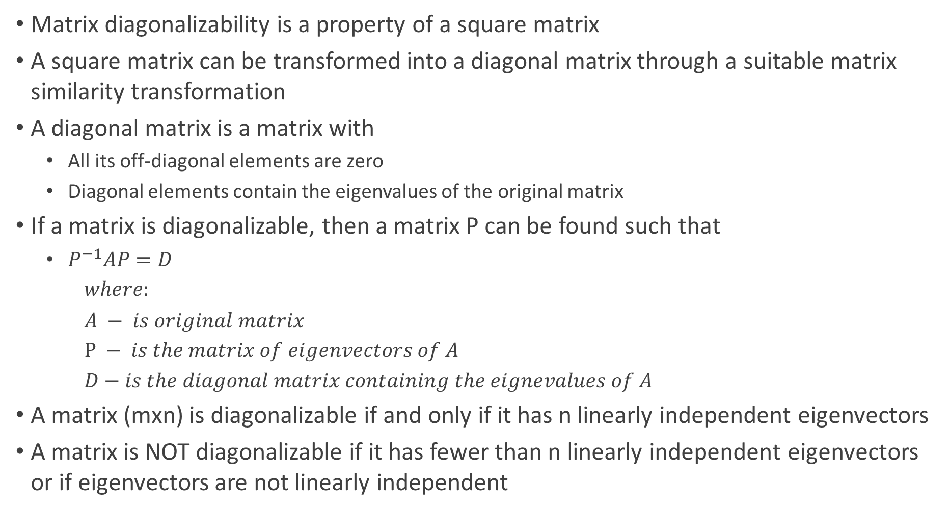
Matrix Diagonalizability
Matrix diagonalizability is a property of a square matrix
A square matrix can be transformed into a diagonal matrix through a suitable matrix similarity transformation
A diagonal matrix is a matrix with
All its off-diagonal elements are zero
Diagonal elements contain the eigenvalues of the original matrix
If a matrix is diagonalizable, then a matrix P can be found such that
$P^{−1}AP=D$
$where:$
$A − is original matrix$
$P − is the matrix of eigenvectors of A$
$D−is the diagonal matrix containing the eignevalues of A$
A matrix (mxn) is diagonalizable if and only if it has n linearly independent eigenvectors
A matrix is NOT diagonalizable if it has fewer than n linearly independent eigenvectors or if eigenvectors are not linearly independent

Slide 56

Positive Definite Matrix (Special Kind of Symmetric Matrix)
Symmetric matrices with positive eigenvalues are called positive definite matrices
For a 2x2 matrix $\left[\begin{matrix}a & b \\ c & d\end{matrix}\right]$ $λ_{1},λ_{2}>0 if and only if a>0 and ad−bc>0$

Slide 57
SVD

Slide 58
Hermitian and Unitary Matrices

Slide 59
Conclusion – Application of Linear Algebra

